Slide 1
Ceis114 Course Project
Traffic controller
Creseta binns
Alireza Kavianpour
CEis114 Introduction to digital devices
08/25/2024

Slide 2
Introduction
Building and programming of two-way traffic light controller with a pedestrian crossing and an emergency signal.
The final step is to secure the system so that it could be controlled remotely via a web browser or mobile app.

Slide 3
Project Preparation

Slide 4
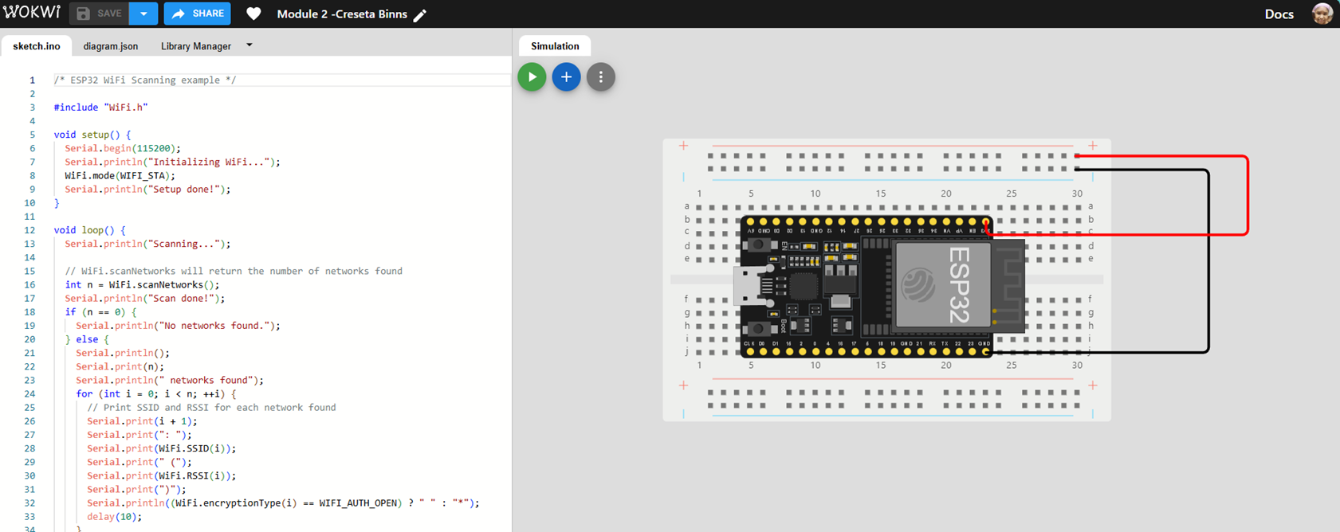
ESP32 (Screenshot)
Microcontroller mounted and powered ON

Slide 5
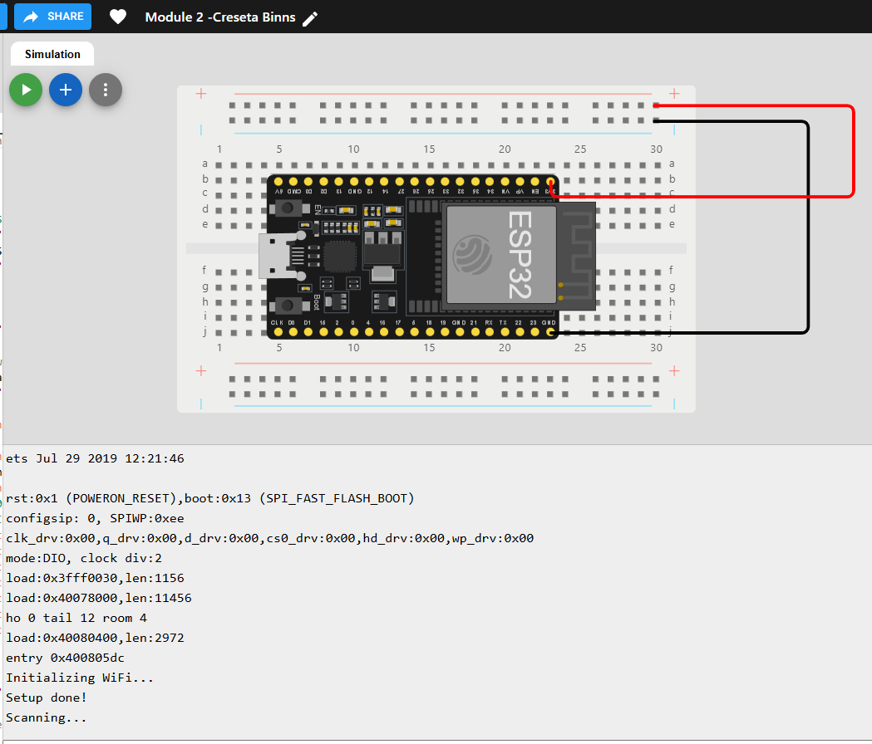
ESP32 WiFi Scan
Screenshot of Serial Monitor showing the available networks

Slide 6
Creating Basic traffic controller

Slide 7
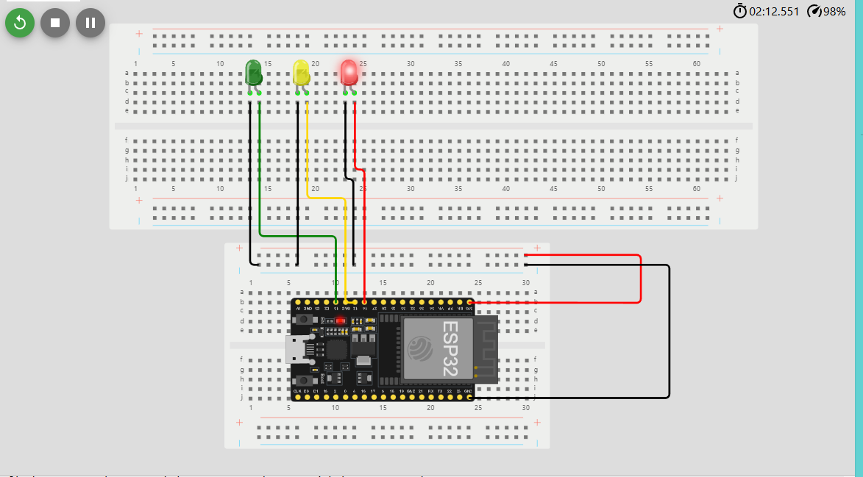
Picture of circuit with working LEDs
ESP 32 Board
Colored LEDs: Red, Yellow and Green
Wires
Breadboard

Slide 8
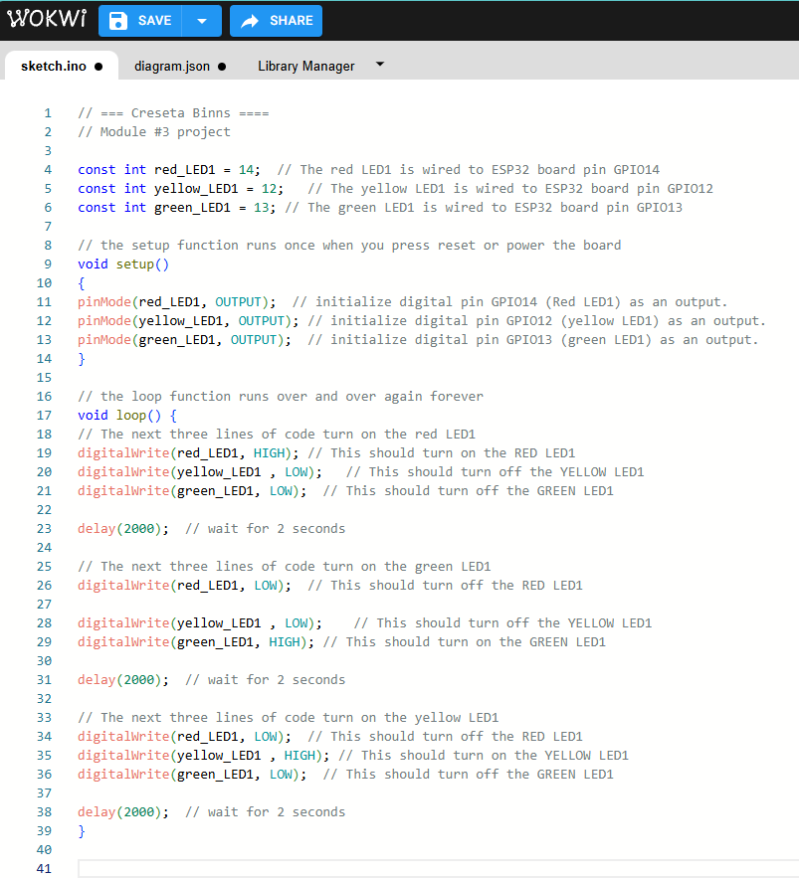
Screenshot of code in the Code Editor
Screenshot of code in the Wokwi Code Editor showing your name in the comment

Slide 9
Multiple traffic lights

Slide 10
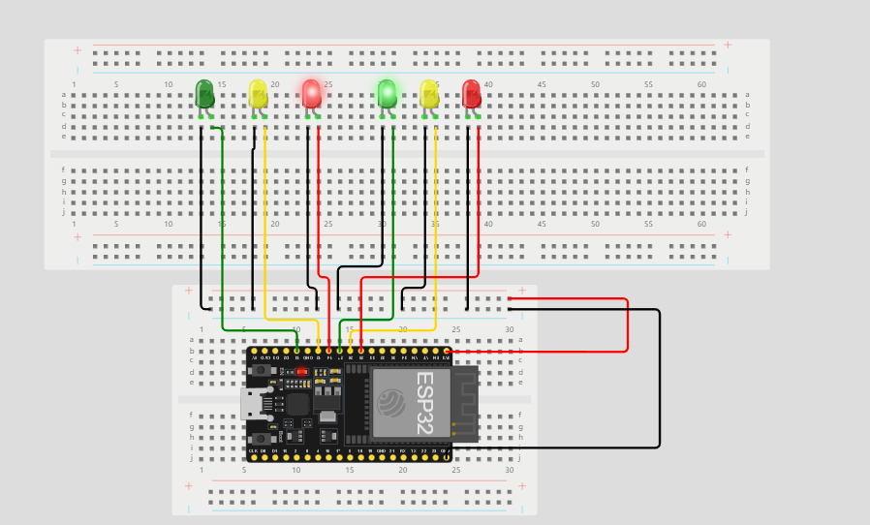
Picture of circuit with working LEDs
ESP 32 Board
Colored LEDs: Red, Yellow and Green (two sets)
Wires
Breadboard

Slide 11
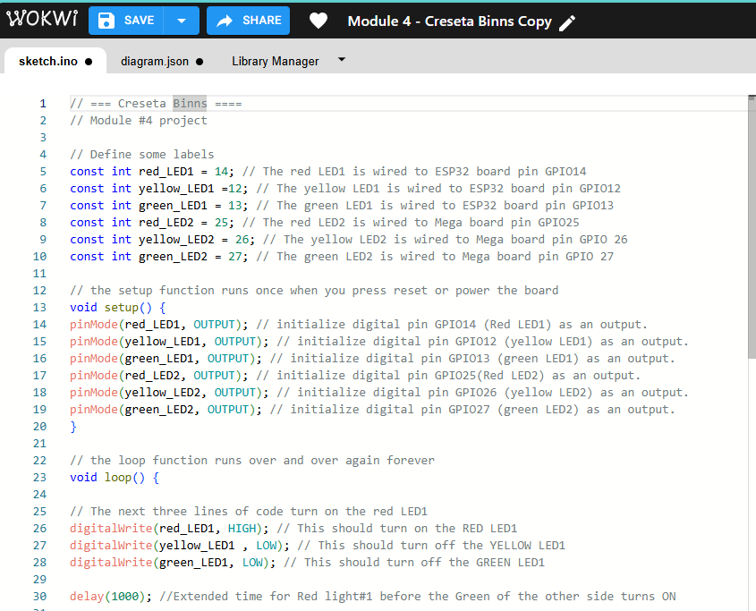
Screenshot of code in the Code Editor
Screenshot of code in the Wokwi Code Editor showing your name in the comment

Slide 12
Adding crosswalk button

Slide 13
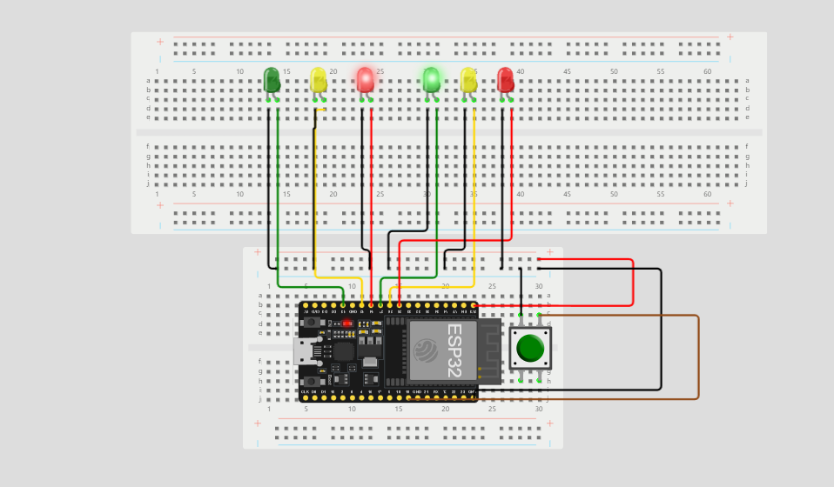
Picture of circuit with working LEDs
ESP 32 Board
Colored LEDs: Red, Yellow and Green (two sets)
220 Ohm Resistors (optional)
Push Button
Wires
Breadboard

Slide 14
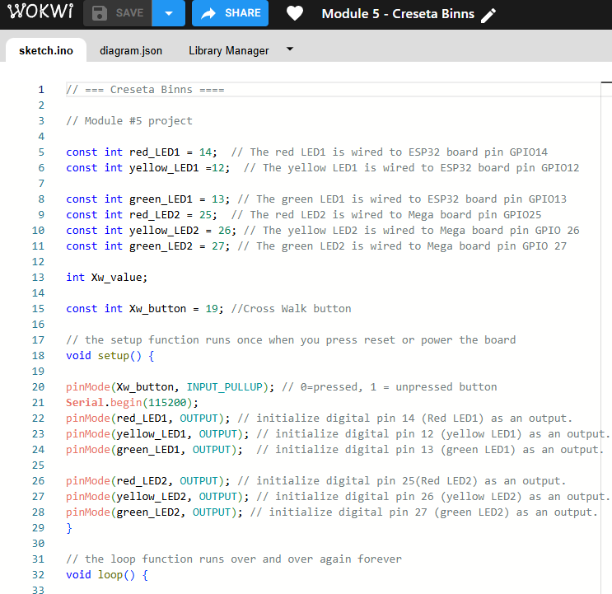
Screenshot of code in the Code Editor
Screenshot of code in the Wokwi Code Editor showing your name in the comment

Slide 15
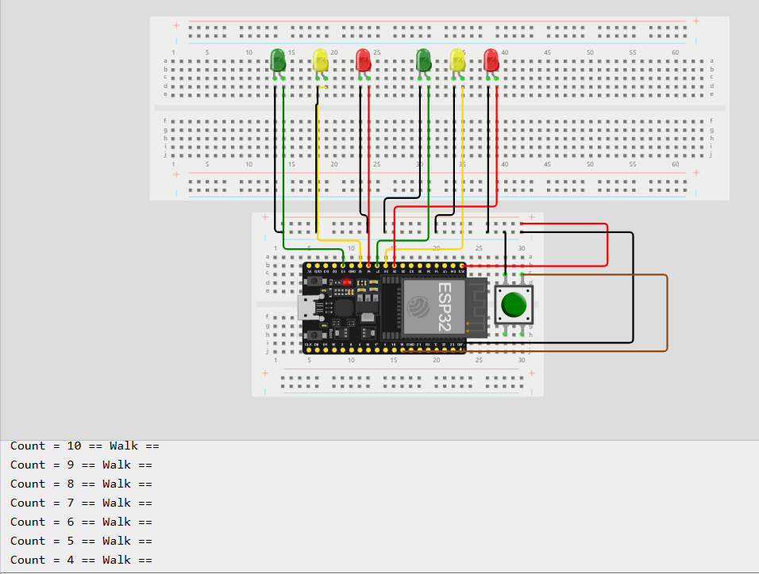
Screenshot of Serial Monitor in Wokwi
Screenshot of output in Serial Monitor

Slide 16
Adding buzzer and lcd display

Slide 17
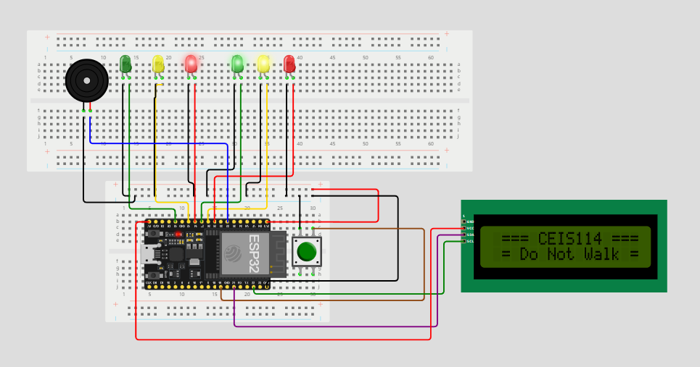
Picture of circuit with working LEDs
ESP 32 Board
Colored LEDs: Red, Yellow and Green (two sets)
220 Ohm Resistors (optional)
Push Button
LCD Unit with Message Display
Wires
Breadboard

Slide 18
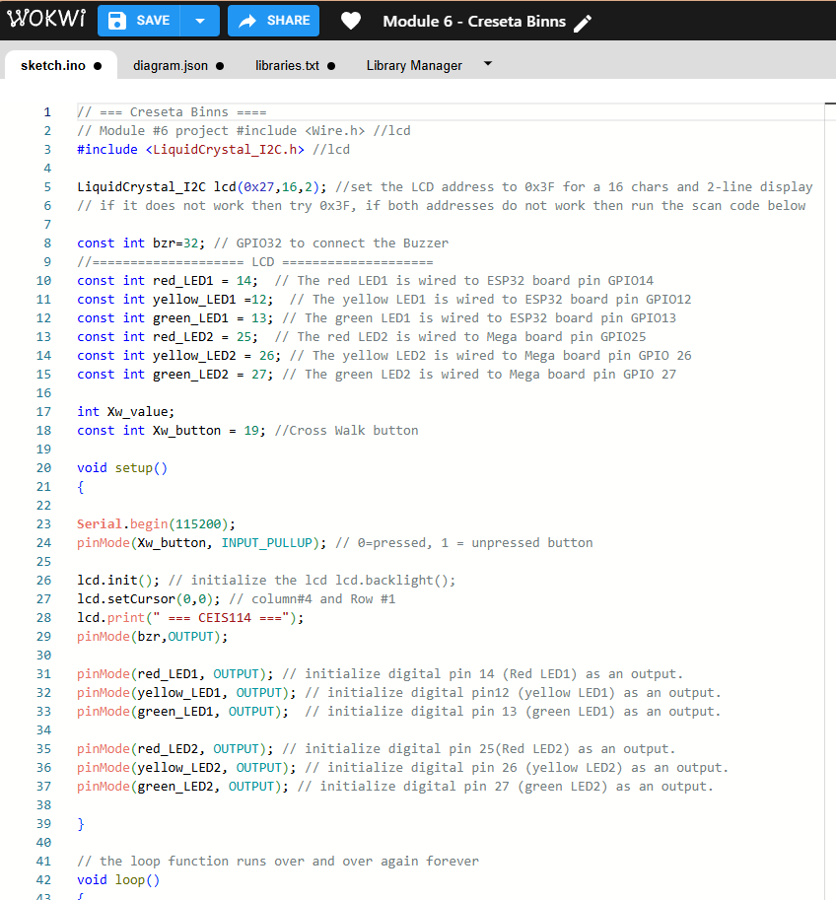
Screenshot of code in the Code Editor
Screenshot of code in the Wokwi Code Editor showing your name in the comment

Slide 19
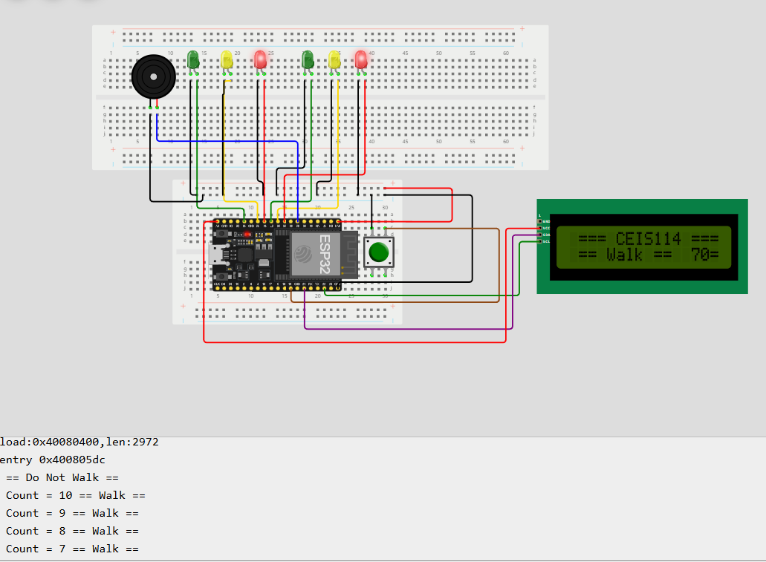
Screenshot of Serial Monitor in Wokwi
Screenshot of output in Serial Monitor

Slide 20
Adding Remote Emergency control

Slide 21
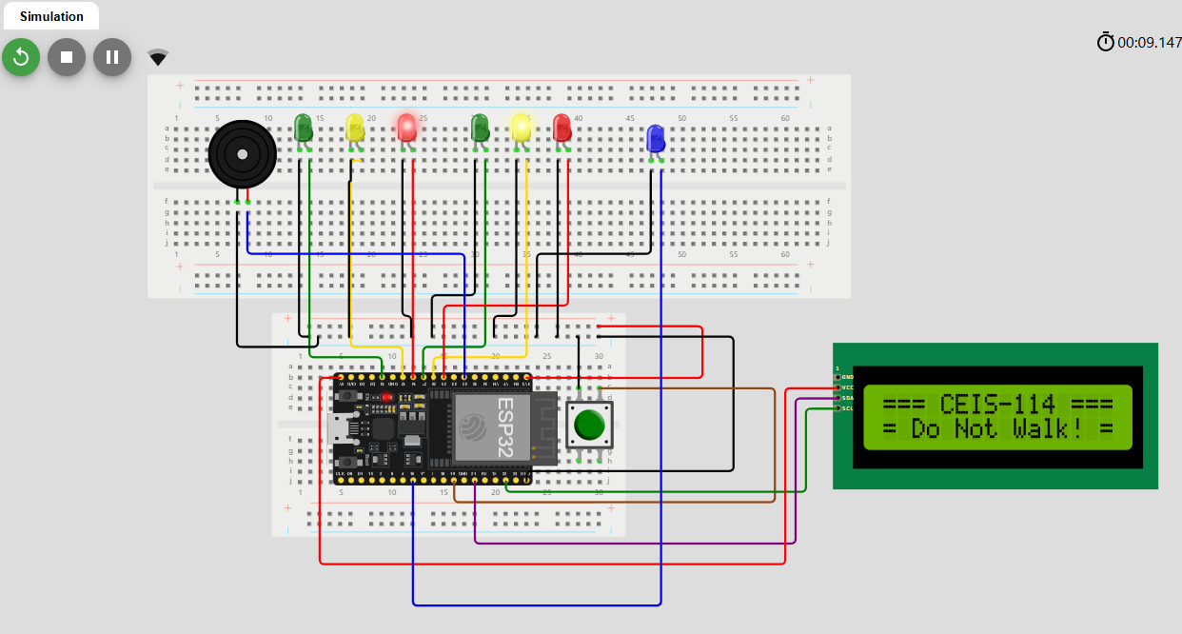
Screenshot of circuit with working LEDs and LCD display (Building/Operation)
ESP 32 Board
Colored LEDs: Red, Yellow and Green (two sets)
One Blue LED – Emergency Light Push Button
LCD Unit
Buzzer
Wires
Breadboard

Slide 22
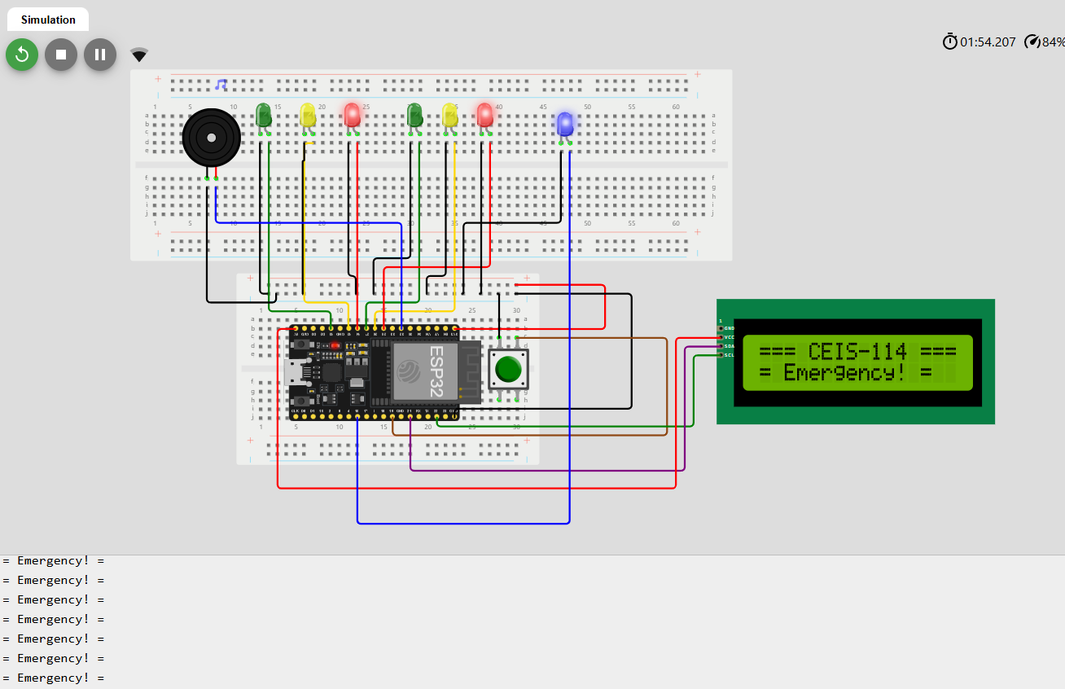
Screenshot of circuit with working LEDs and LCD display (Building/Operation)
ESP 32 Board
Colored LEDs: Red, Yellow and Green (two sets)
One Blue LED – Emergency Light ON
Push Button
LCD Unit
Buzzer
Wires
Breadboard

Slide 23
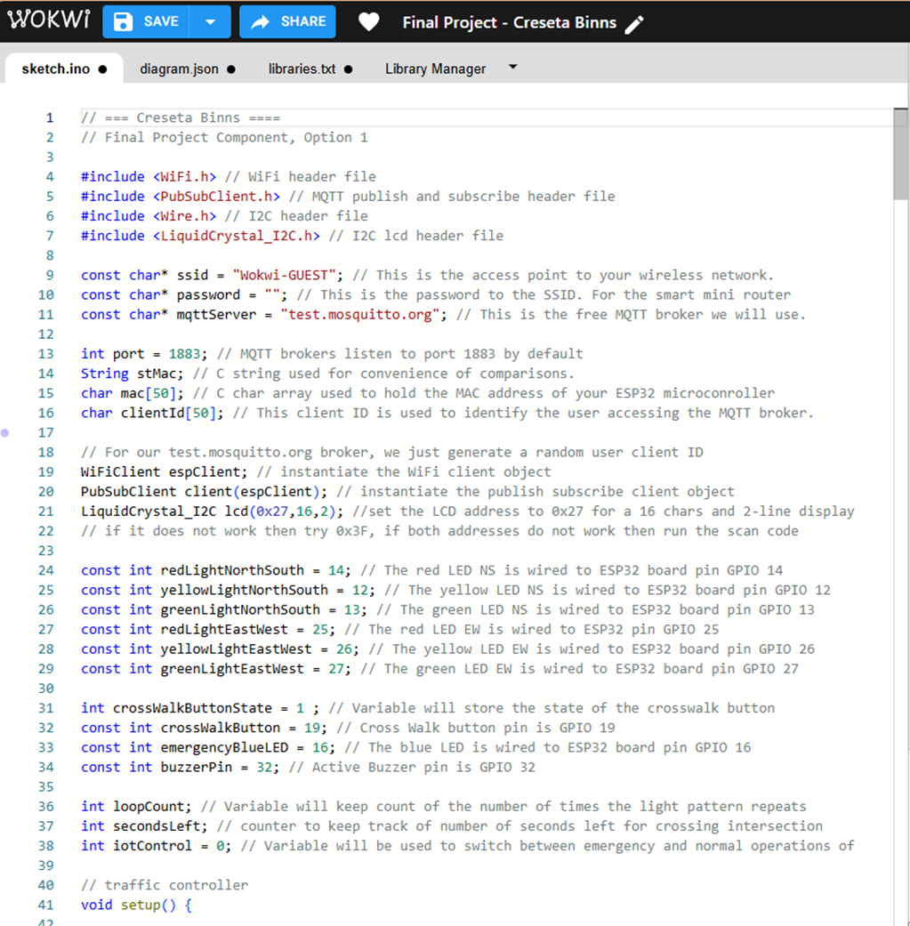
Screenshot of code in Code Editor (Testing)
Screenshot of code in the Wokwi Code Editor showing your name in the comment

Slide 24
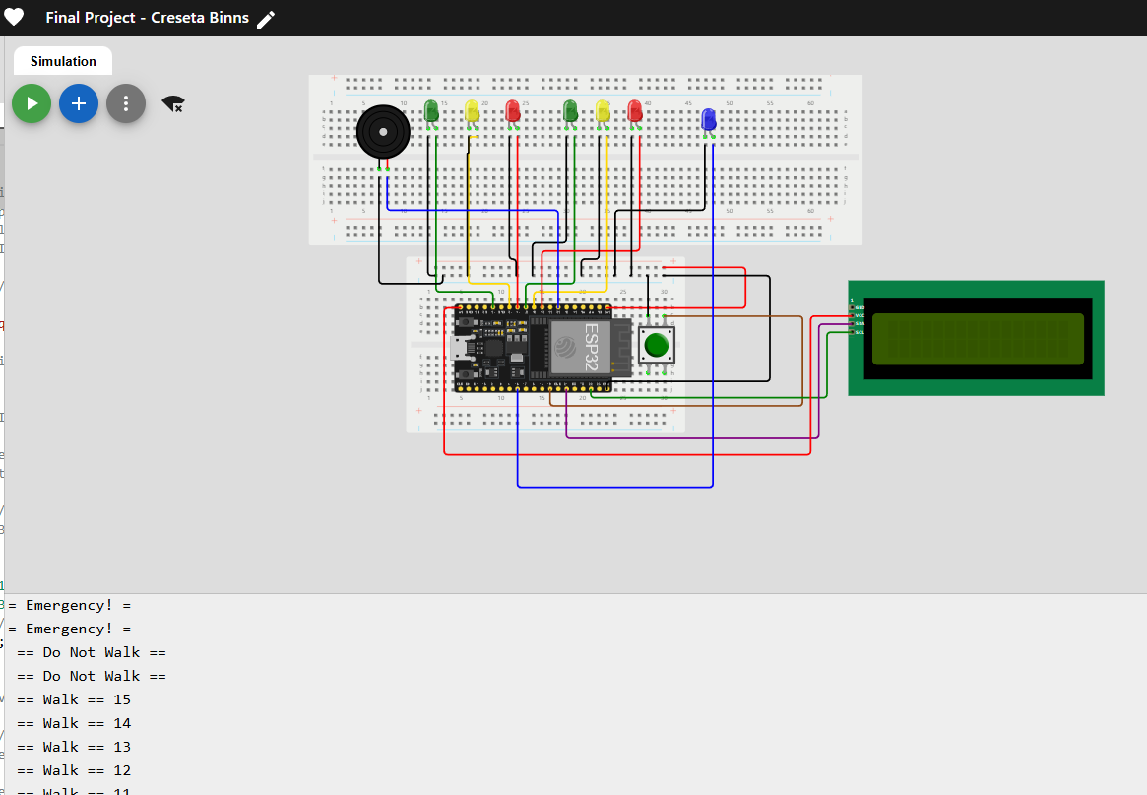
Screenshot of Serial Monitor (Testing)
Screenshot of output in Serial Monitor

Slide 25
Challenges
Manipulating two breadboards for ESP32 in Wokwi
Selecting correct ESP32 microprocessor in Wokwi
Determining pin placement on ESP32
Forgetting to save project in Wokwi

Slide 26
Career Skills
Understanding of the IoT
Hardware/Device knowledge
Networking/Connectivity ability
Coding/Programming
Operating system fundamentals
Automation
Security awareness

Slide 27
Conclusions
This course project encompasses the many areas of the IoT.
Will help prepare me for this emerging industry with lots of exciting job prospects.

Slide 28
Wix Portfolio website link
https://cbinns8.wixsite.com/my-portfolio

