Slide 1
Smart Home Automation and Security System
CEIS101 Final Course Project
Creseta Binns
Prof. Jose Rodriguez

Slide 2
Introduction
Develop a smart home automation and security system by
  designing prototype in Tinkercad
  Building the hardware with Tech Core Kit
  Programming within Arduino IDE
The smart home system will encompass various devices to monitor the condition of the home.
  door sensor to check whether the door is open or closed
  distance sensor to monitor for a possible home intruder
  automated lights that turn on when it is dark

Slide 3
CEIS101
Module 2
Circuit Simulation in Tinkercad

Slide 4
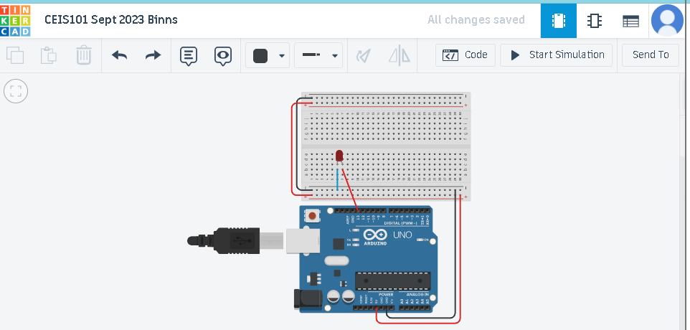
Circuit (screenshot)

Slide 5
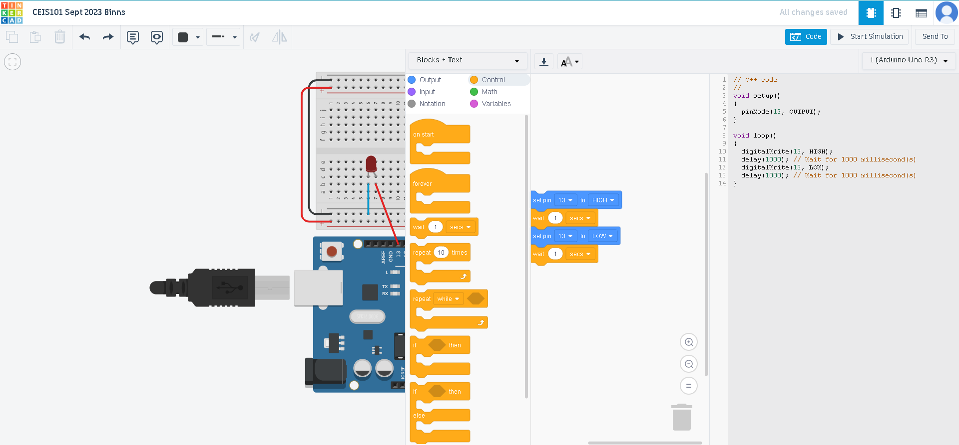
Code (screenshot)

Slide 6
CEIS101
Module 3
Inventory of Parts, Circuit Building, and Displaying Messages

Slide 7
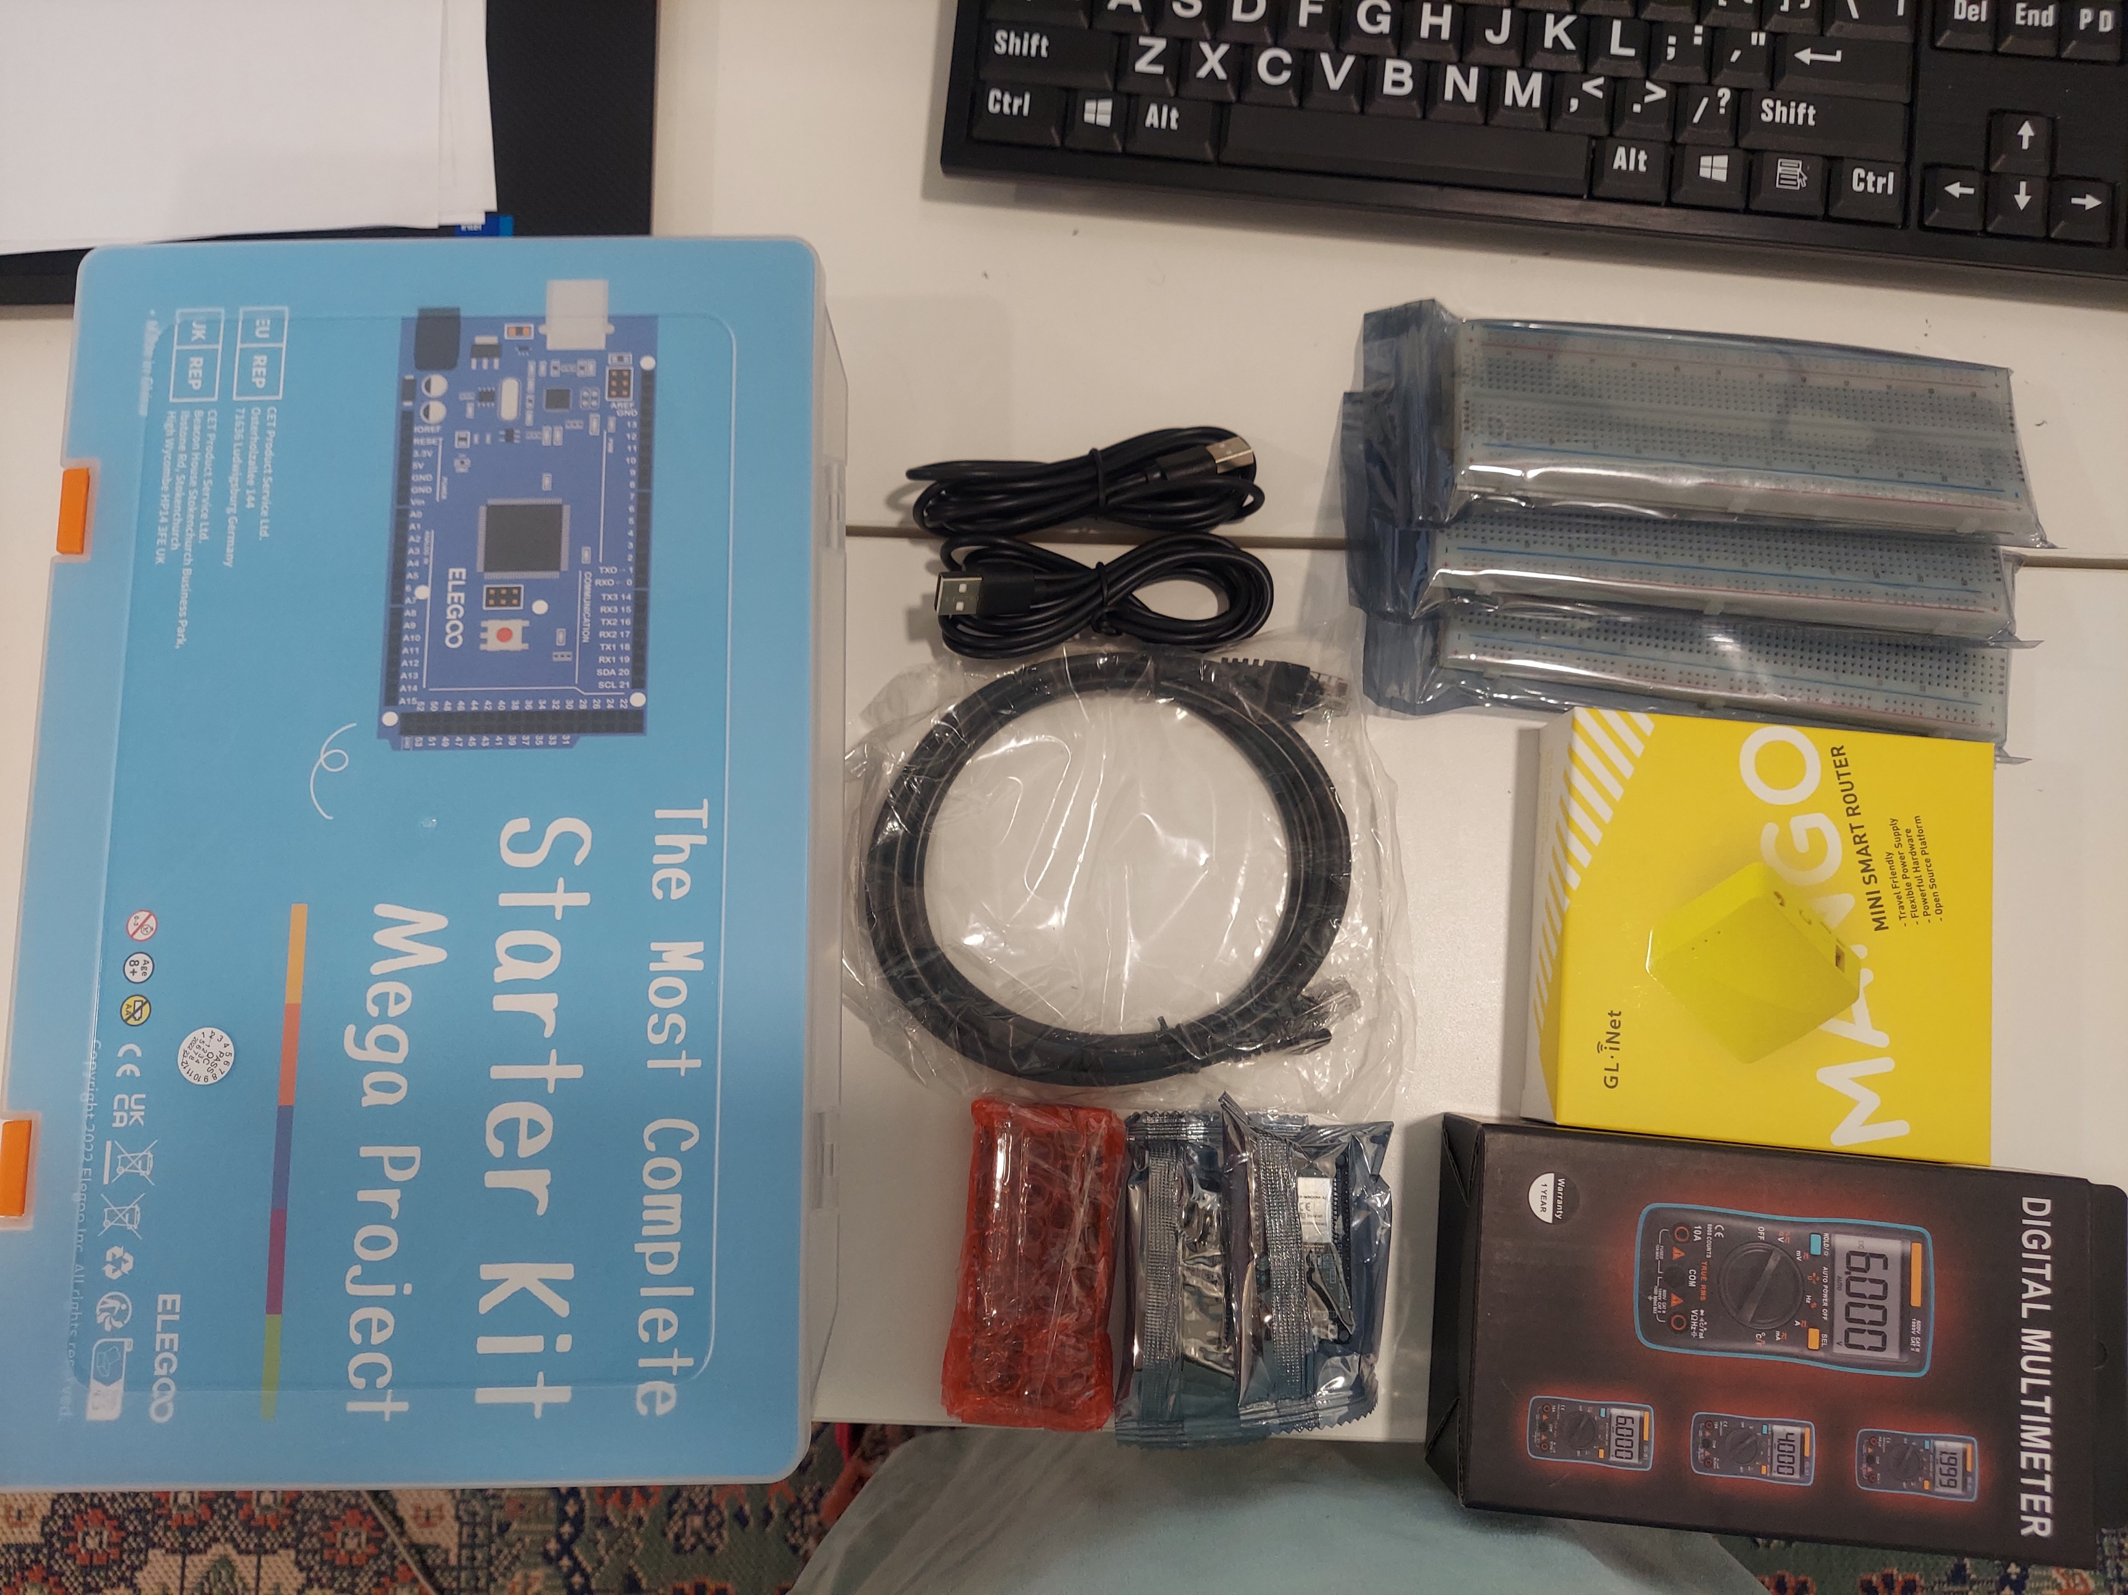
Inventory of IoT Kit (picture)
UCTRONICS Kit
ESP32 (2)
LCD Modules (2)
Breadboards (3)
Mini Router
Patch Cable
Digital Multi Meter
USB to Micro USB (2)

Slide 8
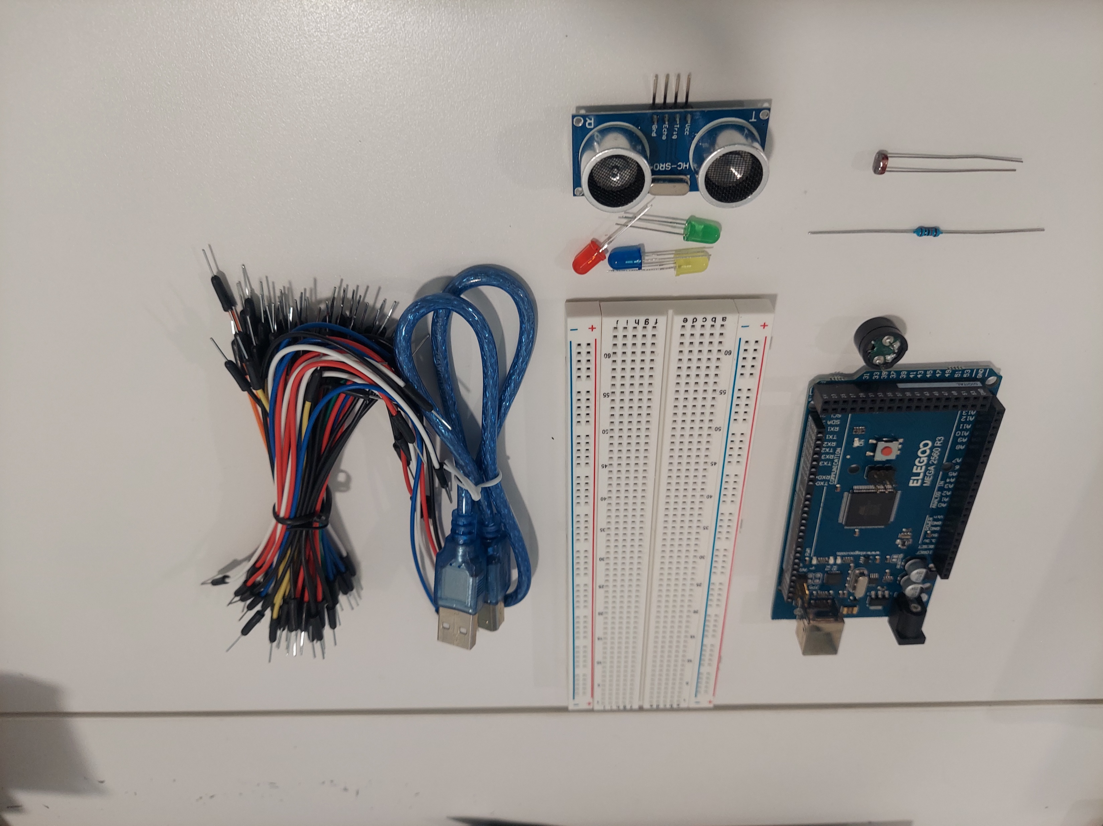
Organization of Project Components (picture)
Arduino Mega 2560
Breadboard
Resistor 10kΩ
LEDs
Ultrasonic Sensor
Active Buzzer
Photoresistor
Wires
USB Type B cable

Slide 9
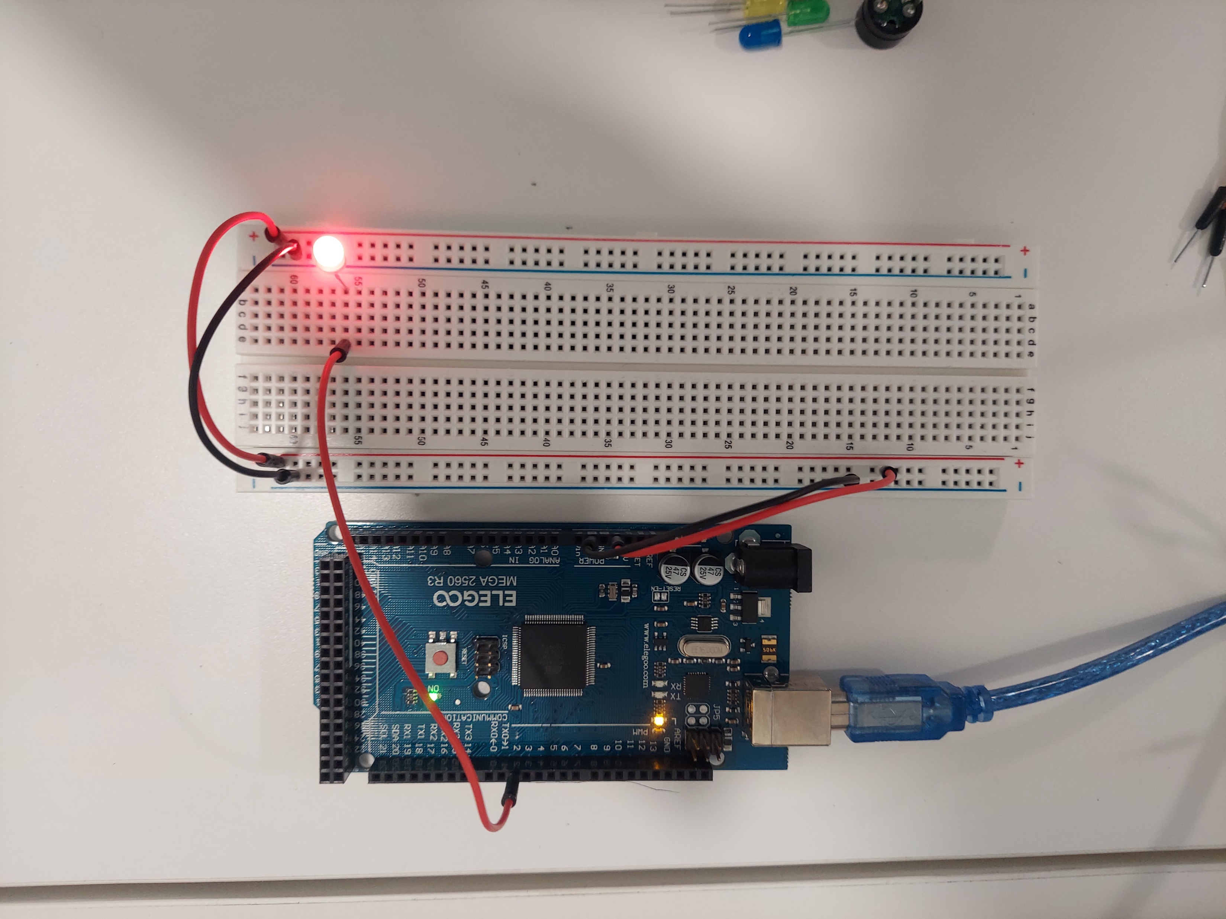
Circuit with red LED on (picture)

Slide 10
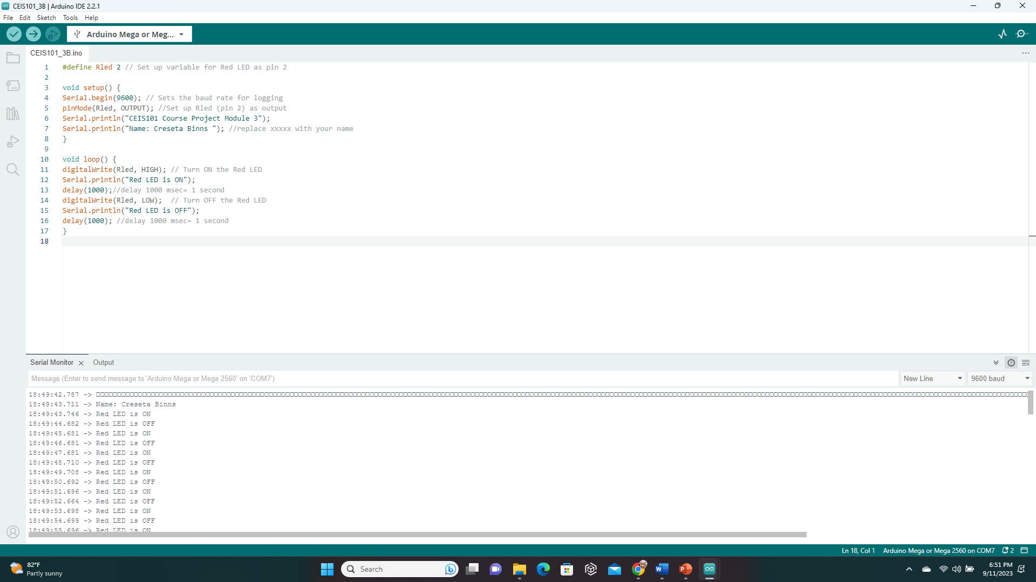
Serial Monitor (screenshot)

Slide 11
CEIS101
Module 4
Adding Door Sensor to Smart Home System

Slide 12
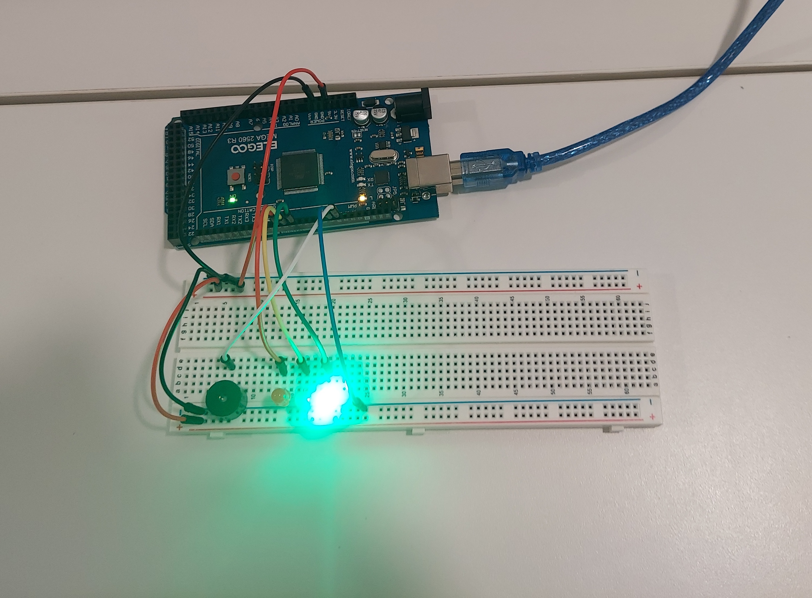
Circuit of door closed with Green LED ON (picture)

Slide 13
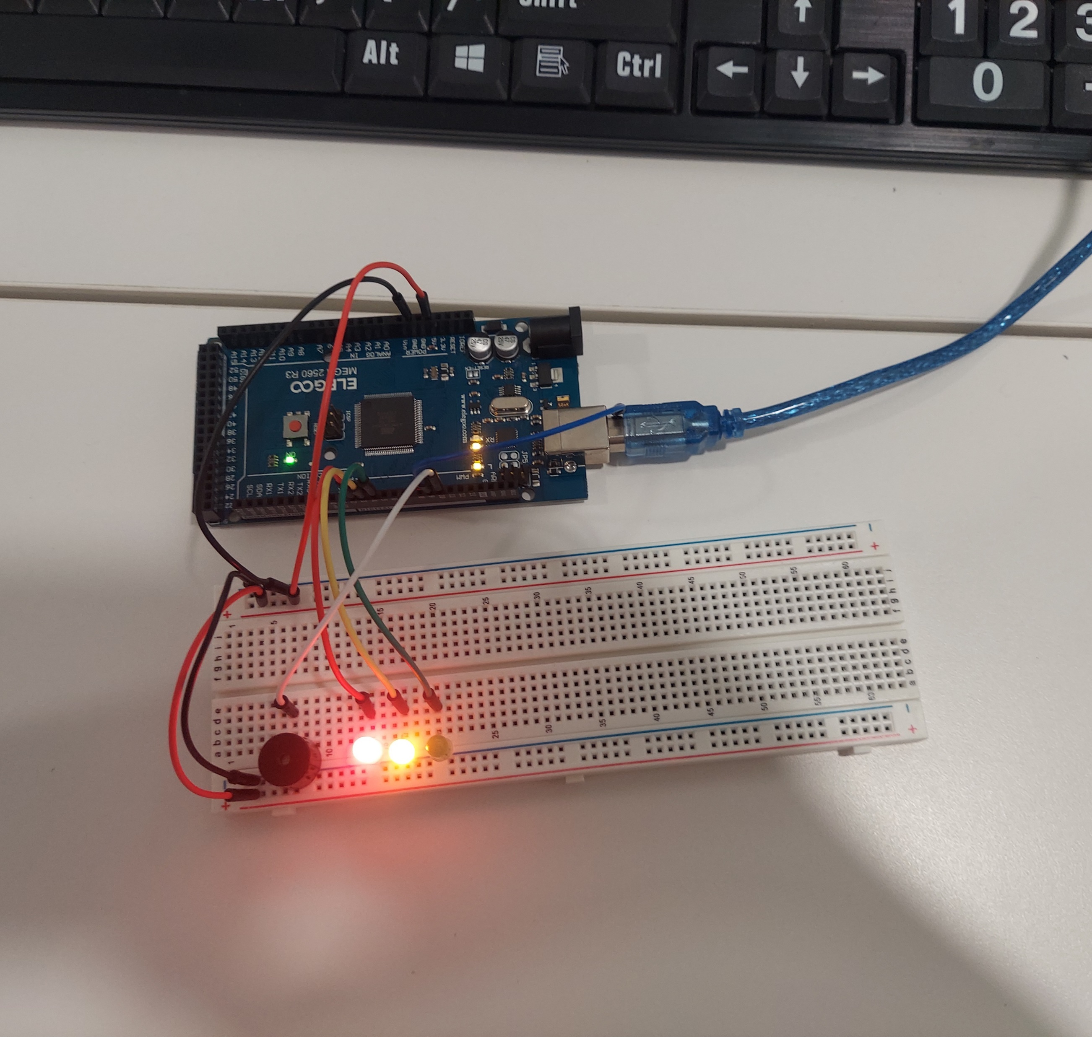
Circuit of door open with Green LED OFF (picture)

Slide 14
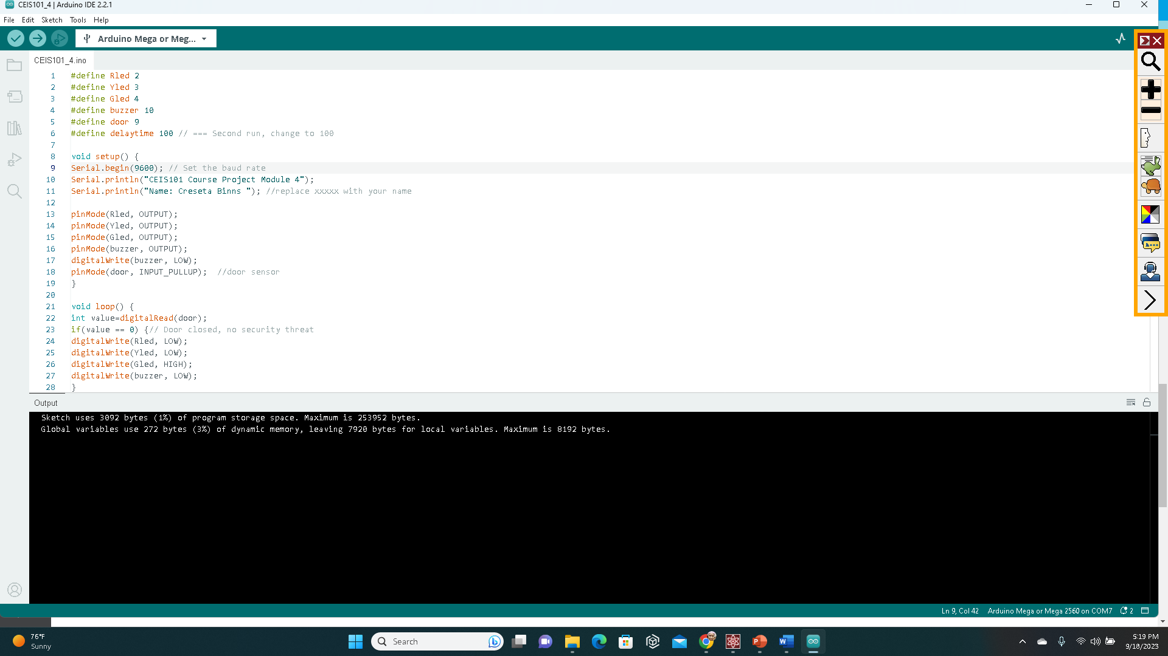
Arduino Code (screenshot)

Slide 15
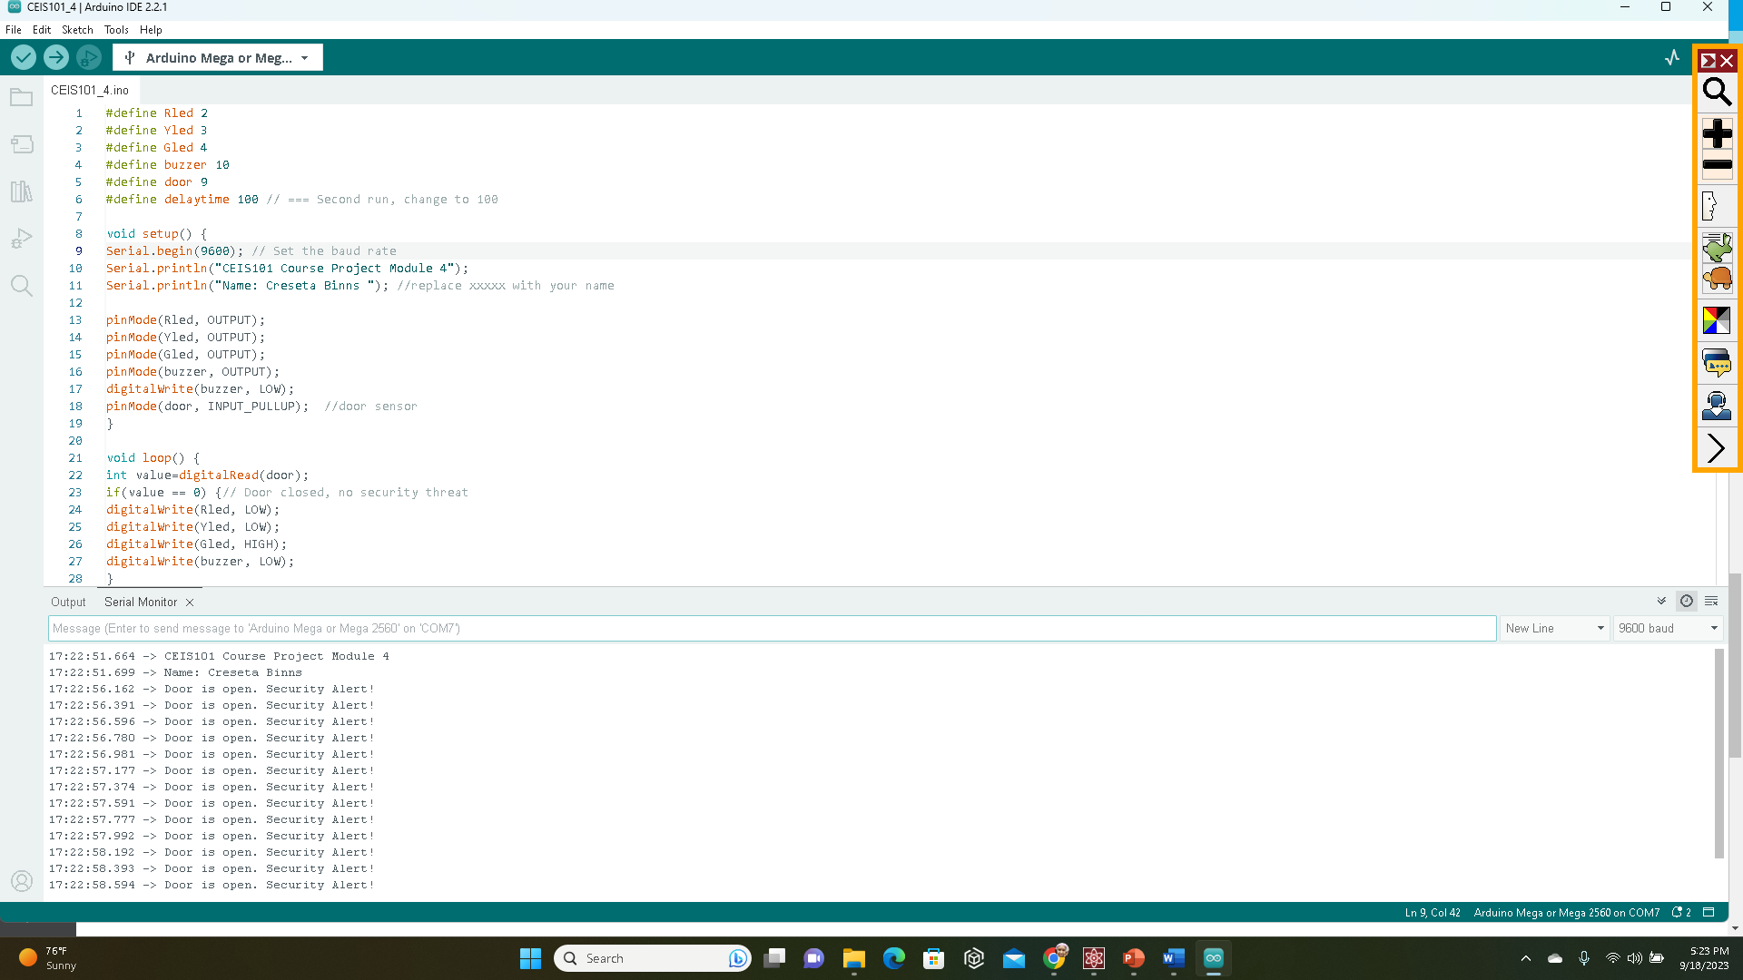
Serial Monitor (screenshot)

Slide 16
CEIS101
Module 5
Adding Distance Sensor to Smart Home System
and Conducting Data Analysis

Slide 17
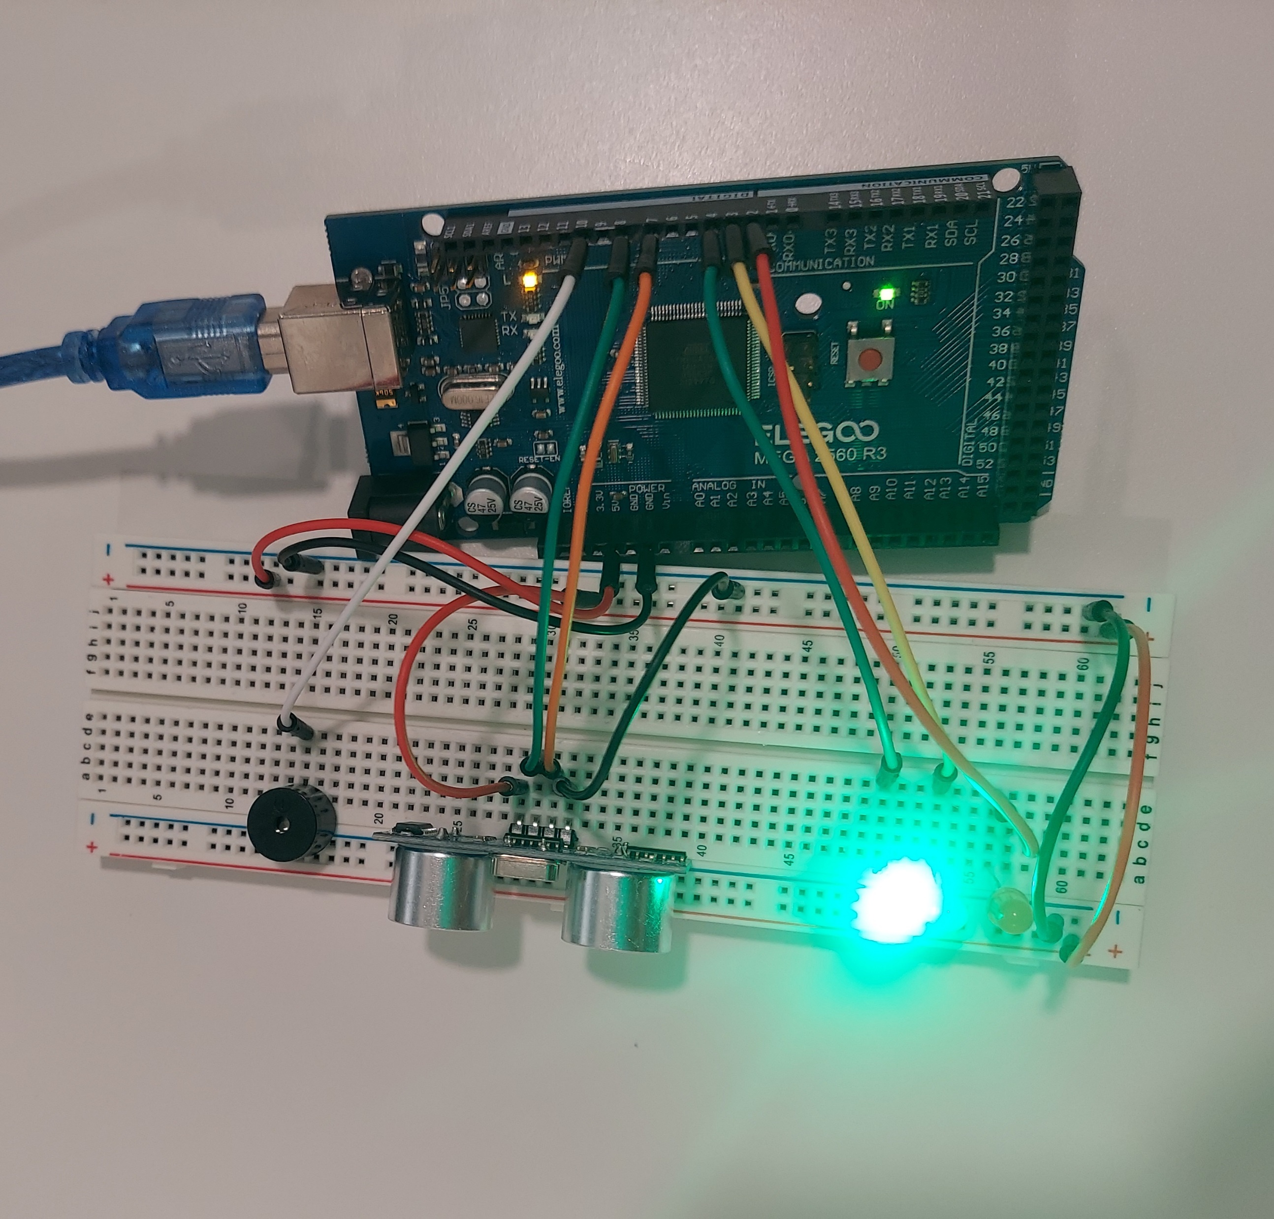
Circuit with green LED on (picture)

Slide 18
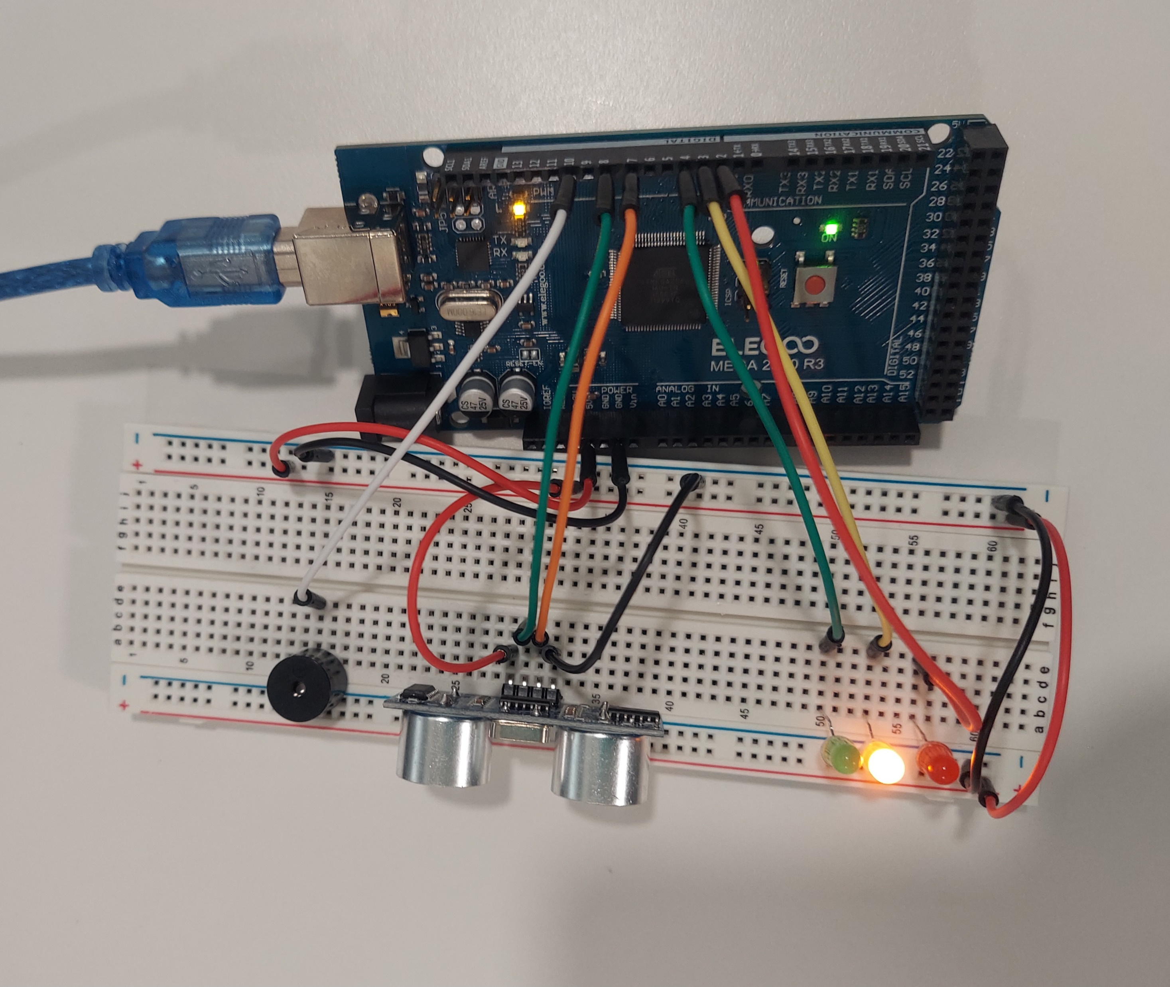
Circuit with yellow LED on (picture)

Slide 19
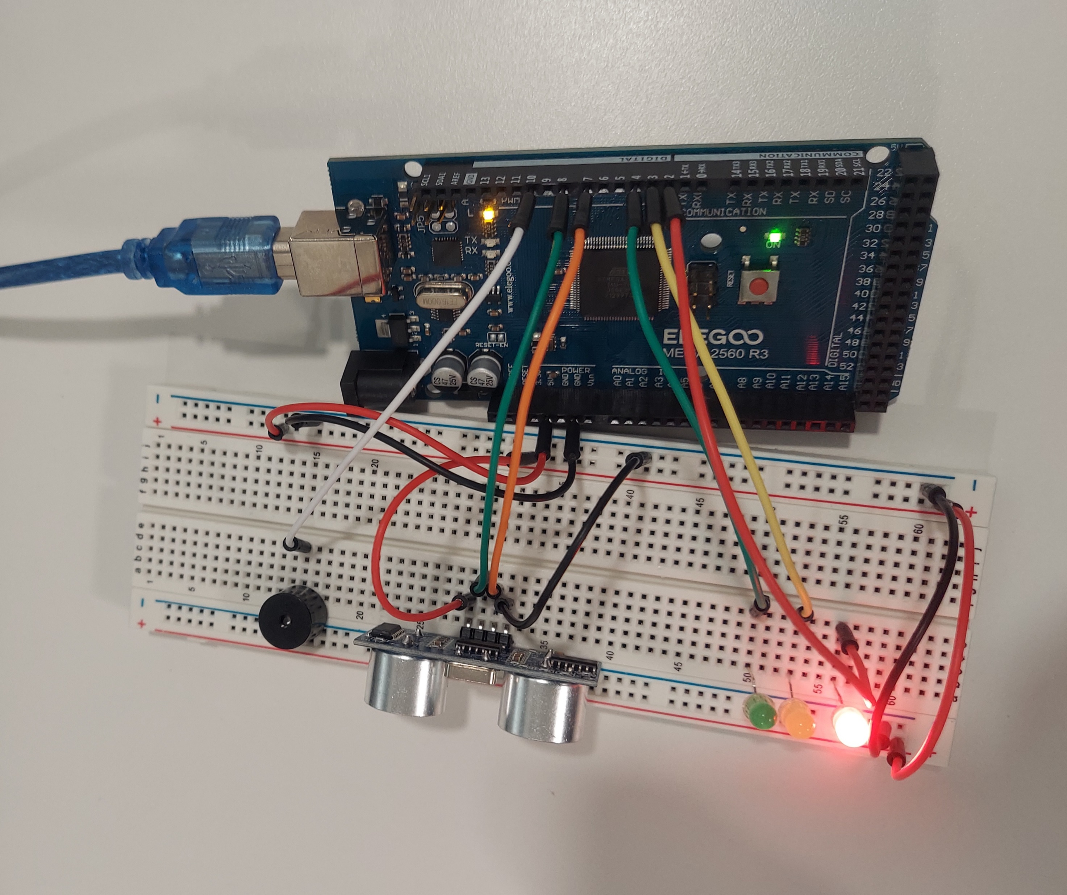
Circuit with red LED on (picture)

Slide 20
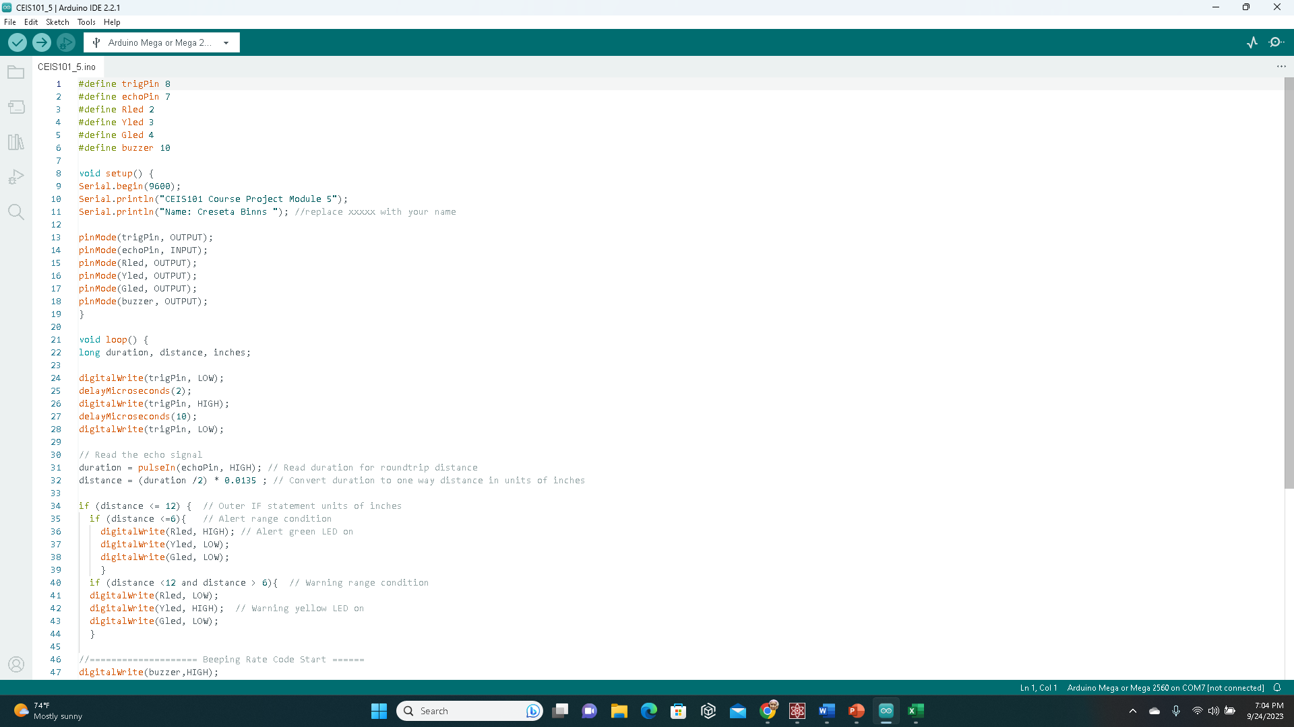
Arduino Code (screenshot)

Slide 21
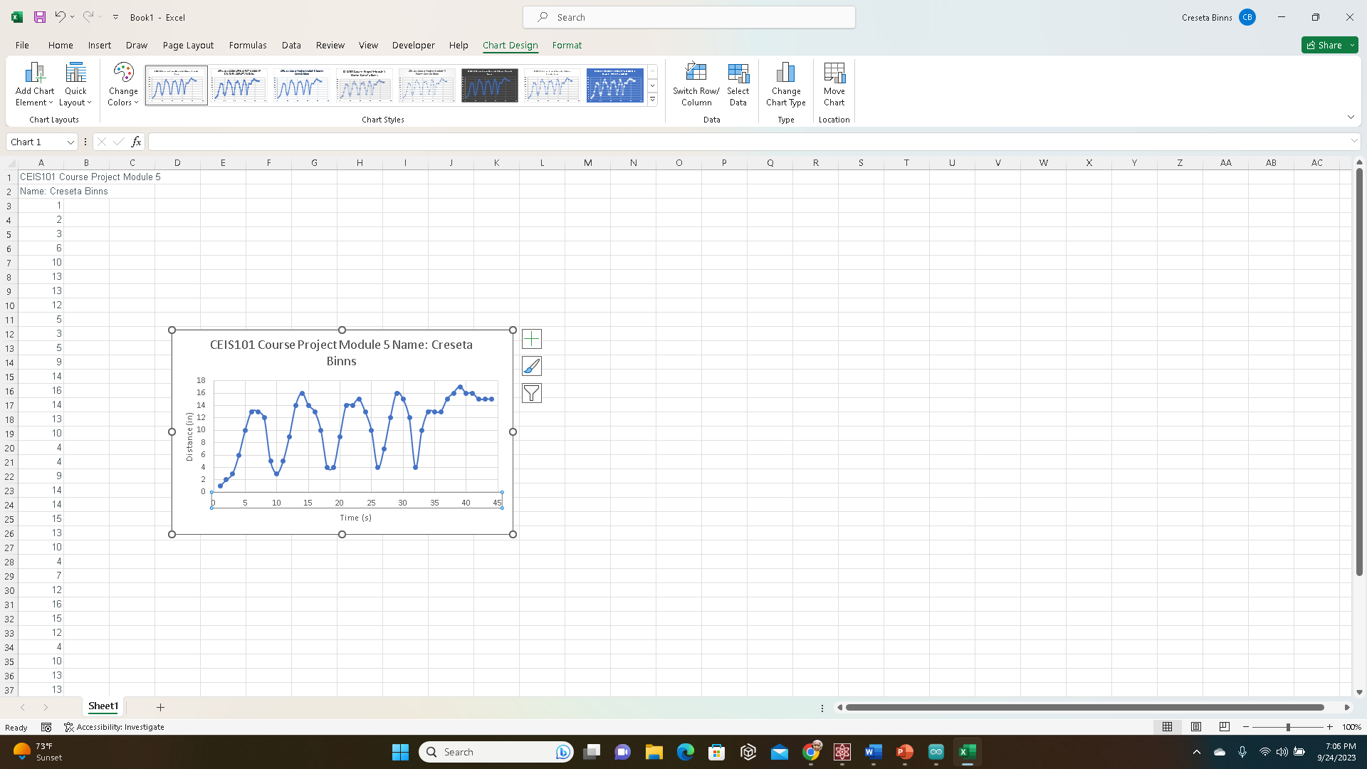
Plot of data (graph from Excel)

Slide 22
CEIS101
Module 6
Adding Automated Light to Smart Home System

Slide 23
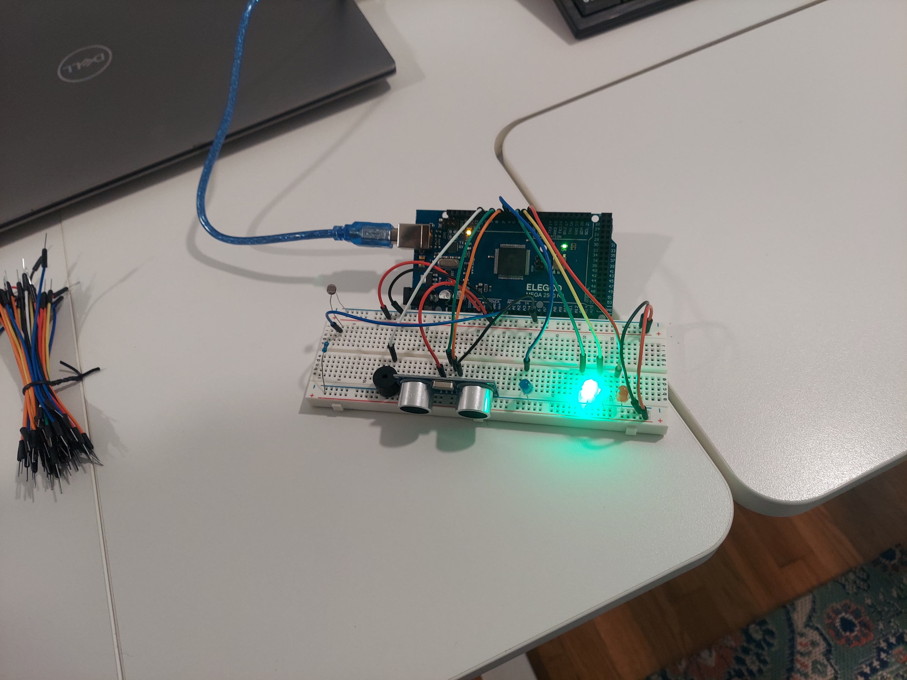
Circuit with automated LED off (picture)

Slide 24
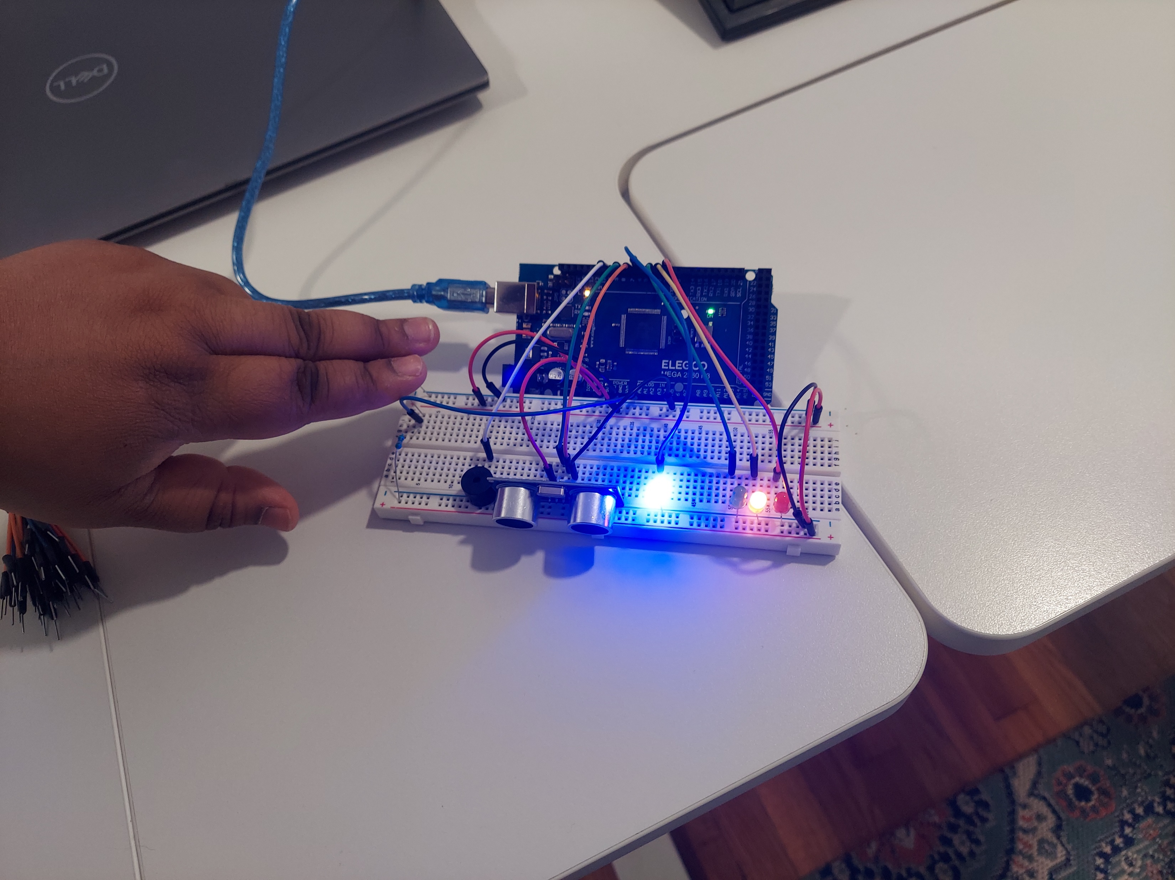
Circuit with automated LED on (picture)

Slide 25
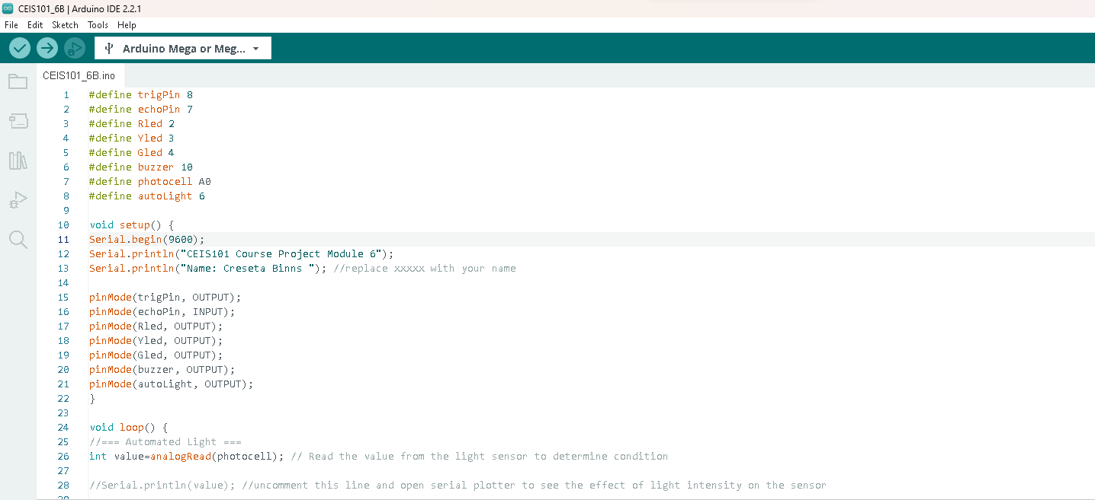
Arduino Code (screenshot)

Slide 26
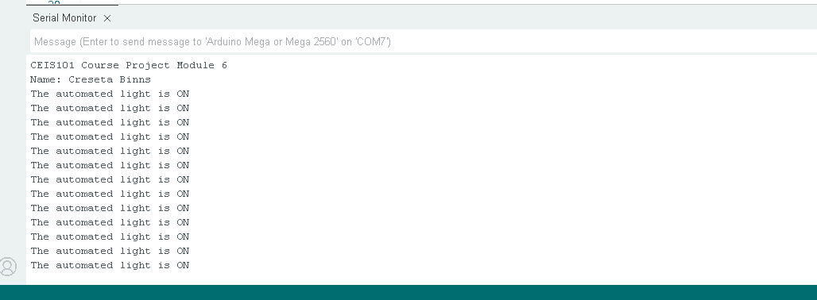
Serial Monitor (screenshot)

Slide 27
Challenges
The code would not upload right I forgot to copy the last curly bracket of the code from the instructions page.
I couldn’t extract the driver file correctly, I had to do it a couple of times for it to work.
Trying to find the 5V pin and the ground pin was difficult because it was not labeled.

Slide 28
Career Skills
Hardware/ device knowledge
Networking/ connectivity ability
Coding/ programming
Understanding of the IoT
Operating system fundamentals
Basic business intelligence and data analytics knowledge
Automation
Security awareness (at a minimum)

Slide 29
References
My references for this project include information from the weekly lessons.

