Slide 1
SEC285 Final Project Deliverable
Creseta Binns

Slide 2
Introduction
The rapid growth of the Internet of Things (IoT) has revolutionized the technology landscape, bringing both opportunities and security challenges. As new applications emerge, ensuring robust cybersecurity measures is more critical than ever. This project focuses on implementing key security configurations, including encryption, stateful firewalls, multi-factor authentication, and vulnerability assessments within a Microsoft Hyper-V environment. Through this project, I have developed hands-on expertise in securing virtualized systems and mitigating potential threats, showcasing my ability to apply cybersecurity principles effectively.

Slide 3
Asymmetric Key Encryption

Slide 4


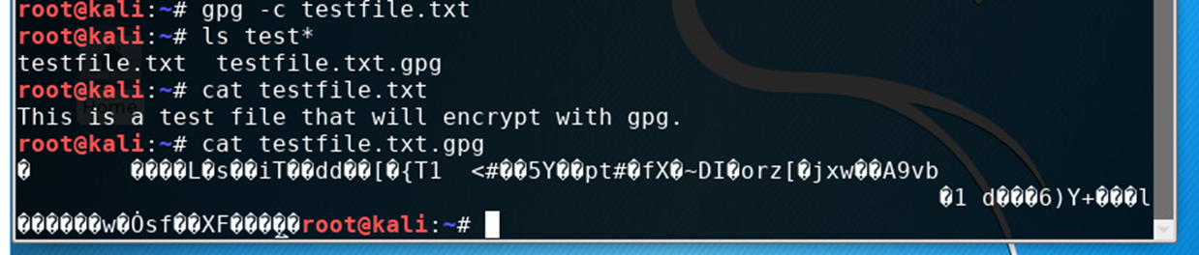
File Encryption
In this part of the project, I used Kali Linux to show a plaintext file and what that file looked like after I encrypted it.

Slide 5
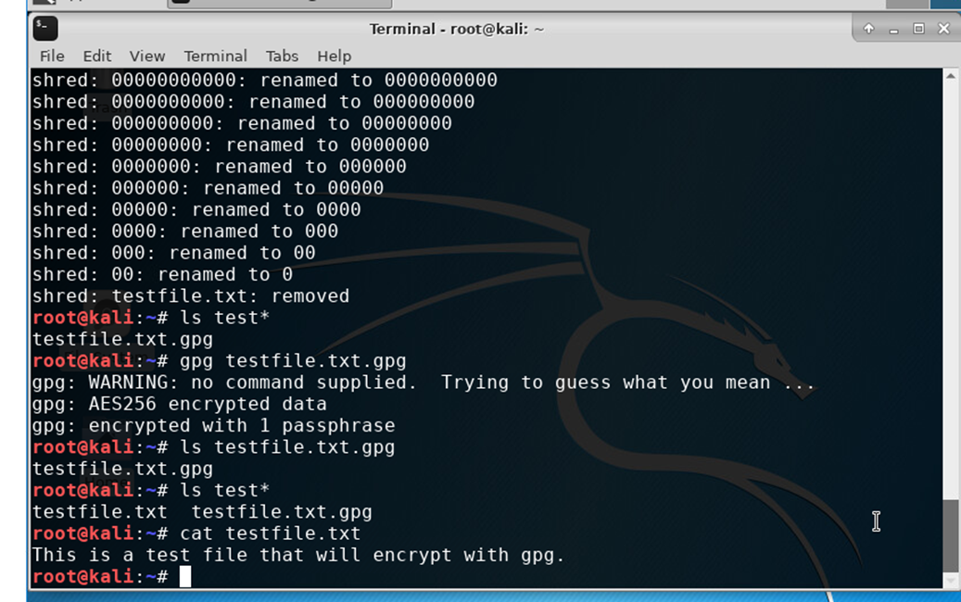
File Decryption
In this part of the project, It shows that I decrypted the file.

Slide 6
Stateful Firewall

Slide 7
Sudo iptables – policy input drop command
What effect does the sudo iptables --policy INPUT DROP command have on the access to computing resources?
The command "sudo iptables --policy INPUT DROP" significantly restricts access to computing resources by setting the default policy for incoming network traffic to "DROP", meaning that all incoming packets will be blocked unless explicitly allowed by other rules within the firewall, effectively preventing most external access to the system unless specific exceptions are configured to allow legitimate traffic.

Slide 8
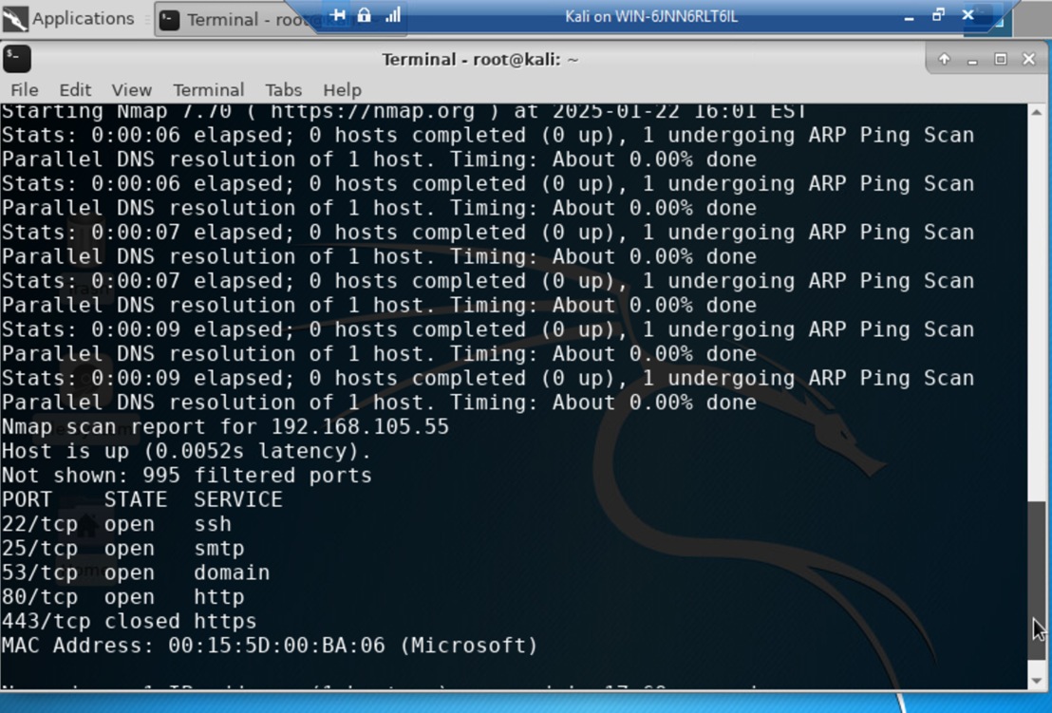
Nmap scan
This part of the project shows the Nmap scan result of the Linux Server VM.

Slide 9
Bring your own device (BYOD) security policy

Slide 10
Overview
Tablets, smartphones, and laptops are indispensable tools in modern enterprises. These devices enhance productivity and flexibility, allowing employees to work remotely and stay connected. However, they also introduce risks such as data breaches, malware infections, and unauthorized access to organizational resources.

Slide 11
Purpose
The main purpose of this BYOD Security Policy is to safeguard the confidentiality, integrity, and availability (CIA) of ABC Corporation's data and computing resources. By identifying and mitigating vulnerabilities introduced by personal devices, the organization aims to minimize potential attack vectors and ensure secure operations.

Slide 12
scope
This policy applies to all employees, contractors, and partners who use personal devices to access ABC Corporation's network or data. Approved devices include smartphones, tablets, and laptops. All devices must be registered, approved, and comply with the security standards outlined in this policy.

Slide 13
Policy
All BYOD devices must pass a security assessment before being granted access to ABC Corporation's network. Requirements for compliance include:
- Operating systems with the latest updates and patches.
- Up-to-date antivirus software.
- Active and properly configured firewalls.
Noncompliant devices must undergo remediation before access is permitted. It is the responsibility of the device owner to ensure compliance and address any identified issues promptly.

Slide 14
Policy compliance
Compliance with this policy will be monitored through periodic audits, video monitoring, intrusion detection systems, and regular reviews. Employees who fail to adhere to the policy may face disciplinary action, up to and including termination of employment.

Slide 15
Related standards, policies, and processes
This policy aligns with industry standards and regulations, including HIPAA and PCI-DSS, to ensure the protection of sensitive data. These standards provide additional guidance for securing devices and maintaining compliance.

Slide 16
Definitions and terms
BYOD: Bring Your Own Device.
CIA: Confidentiality, Integrity, and Availability.
Mobile Devices: Portable computing devices such as smartphones, tablets, and laptops.
Remediation: The process of addressing security vulnerabilities to bring a device into compliance with the policy.

Slide 17
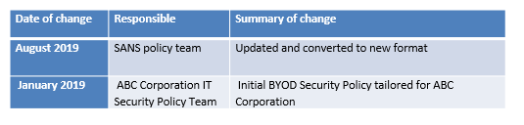
Revision History

Slide 18
Multifactor authentication (MFA)

Slide 19
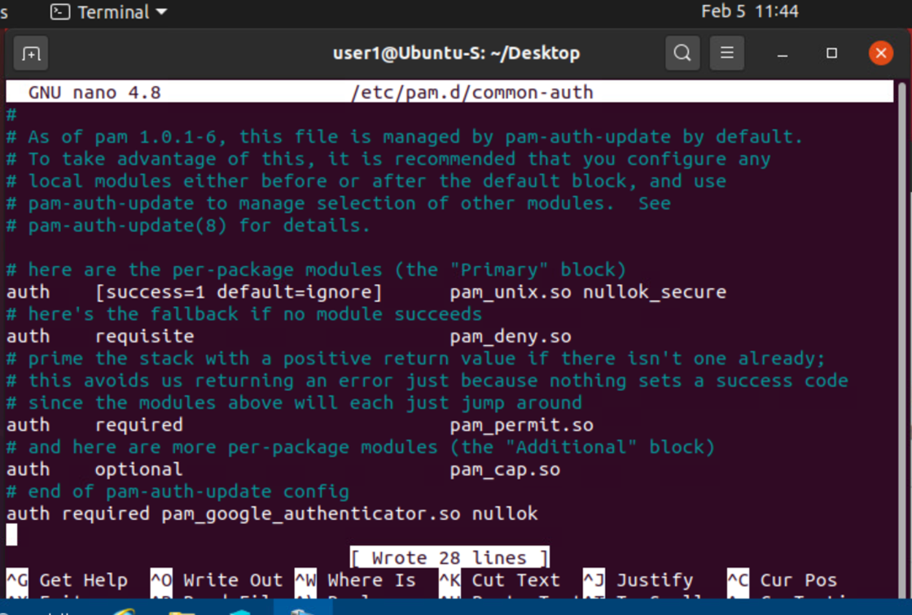
Common-auth Configuration file
This part of the project shows the configuration of the Google authenticator file.

Slide 20
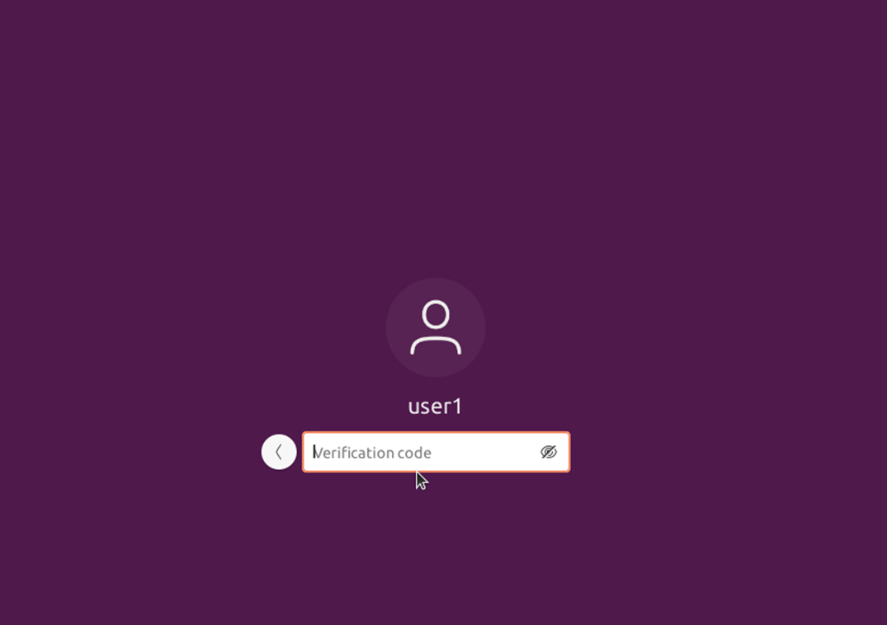
MFA logon screen
This part of the project shows the code verification screen, which gives me confirmation that the multifactor authentication was configured properly.

Slide 21
Vulnerability assessment

Slide 22
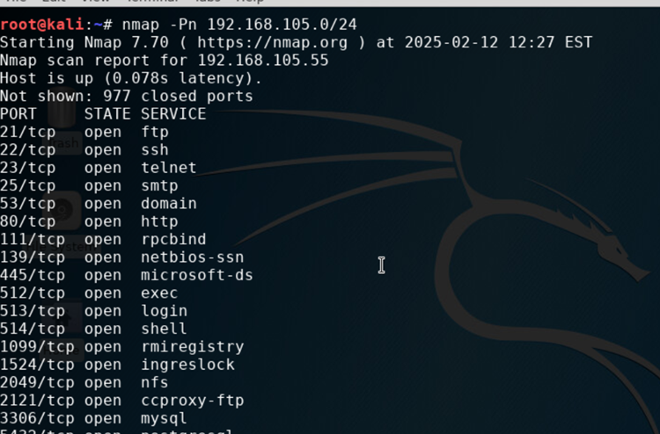
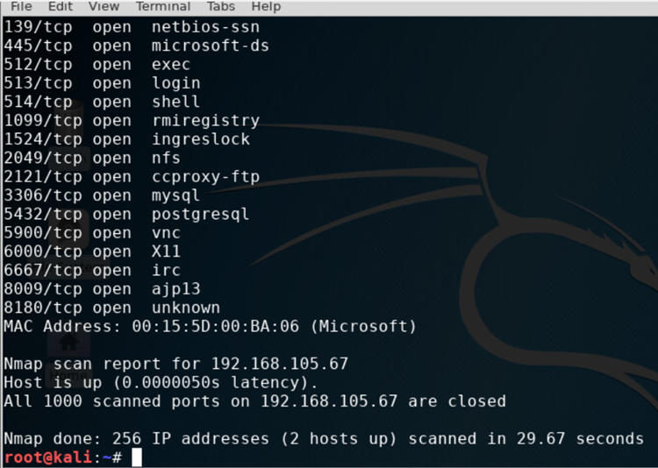
Nmap
This part of the project shows the scan result for both the Kali and Linux Server VM.

Slide 23
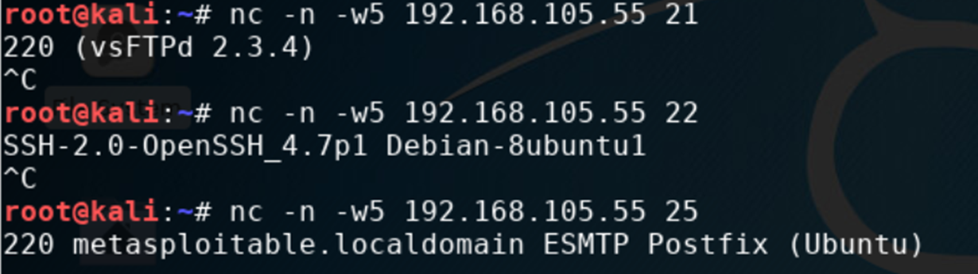
netcat
This part of the project shows the NetCat scan result for both the Kali and Linux Server VMs.

Slide 24
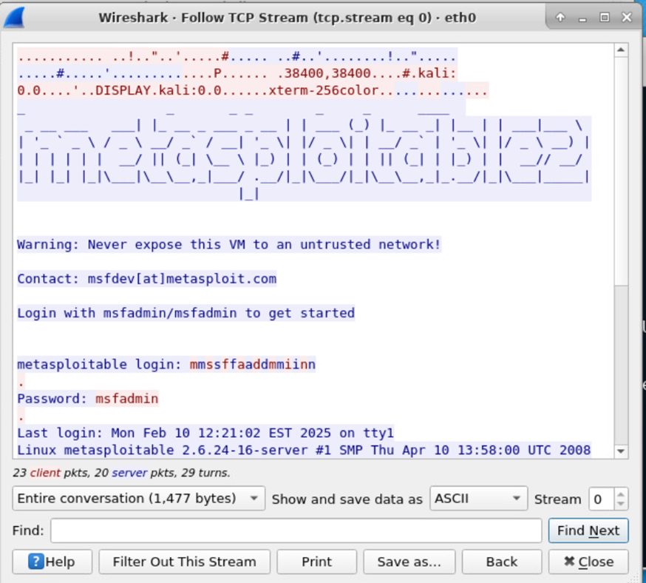
Wireshark
This part of the project shows the Wireshark – Follow TCP Stream window showing the Telnet username and password.

Slide 25
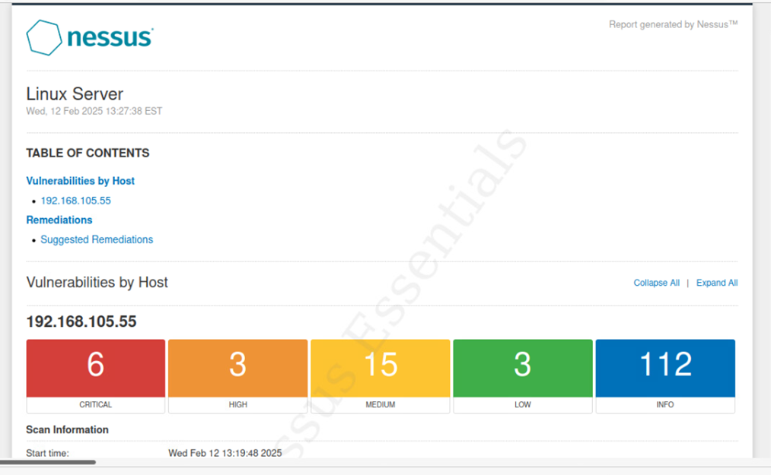
Nessus
This part of the project helped me to show the high-level view of the Nessus vulnerability scan report, also showing the categories of vulnerability in different colors.

Slide 26
Challenges
Throughout this project, I encountered several challenges that tested my problem-solving skills and adaptability. One of the main difficulties was configuring security features within the Microsoft Hyper-V environment, particularly ensuring proper encryption and multi-factor authentication settings. Additionally, troubleshooting firewall rules and conducting vulnerability assessments required extensive research and iterative testing. Another challenge was integrating multiple security tools, such as Nmap, Wireshark, and Nessus, to effectively identify and mitigate potential threats. Despite these obstacles, overcoming them allowed me to gain valuable hands-on experience and deepen my understanding of cybersecurity principles.

Slide 27
Career skills
This project has provided me with hands-on experience in key cybersecurity concepts and technical skills that are essential in the field. I have gained proficiency in configuring and securing virtual environments using Microsoft Hyper-V, implementing encryption protocols, and setting up multi-factor authentication for enhanced security. Additionally, I have strengthened my ability to conduct vulnerability assessments using industry-standard tools like Nmap, Wireshark, and Nessus. Beyond technical expertise, this project has improved my problem-solving skills, attention to detail, and ability to analyze security risks. These skills are directly applicable to roles in cybersecurity, IT security administration, and network security analysis, preparing me for a successful career in the field.

Slide 28
Conclusion
This project has been a valuable learning experience, allowing me to apply fundamental cybersecurity principles in a real-world scenario. By configuring security measures within a Microsoft Hyper-V environment, I gained hands-on experience in encryption, firewall management, multi-factor authentication, and vulnerability assessments. The challenges faced throughout the project helped strengthen my technical problem-solving skills and deepen my understanding of cybersecurity best practices. Overall, this experience has reinforced my passion for cybersecurity and equipped me with essential skills that will contribute to my future career in the field.

Slide 29
References
Lyon, G. (n.d.). Nmap: Network mapper. Retrieved from https://nmap.org/
Microsoft. (n.d.). Securing virtual machines in Hyper-V. Retrieved from https://learn.microsoft.com/en-us/windows-server/virtualization/hyper-v/security-overview
National Institute of Standards and Technology (NIST). (2020). Digital identity guidelines (SP 800-63-3). Retrieved from https://pages.nist.gov/800-63-3/
Wireshark Foundation. (n.d.). Analyzing network traffic with Wireshark. Retrieved from https://www.wireshark.org/docs/
SANS Institute. (2022). BYOD security policy: Best practices for organizations. Retrieved from https://www.sans.org/white-papers/byod-policy/

