Slide 1

CEIS150 Python Stock Tracking Project
Creseta Binns

Slide 2
Introduction
This project shows how to create applications in Python. I used object-oriented techniques to develop a stock tracking application. In the PowerPoint you will see that the application will have both a console and GUI (Graphical User Interfaces). My PowerPoint also shows that by processing the historical stock data, profit/loss report can be generated. You will also see that the system will use the Python libraries to create charts and get historical stock data from web sites.

Slide 3
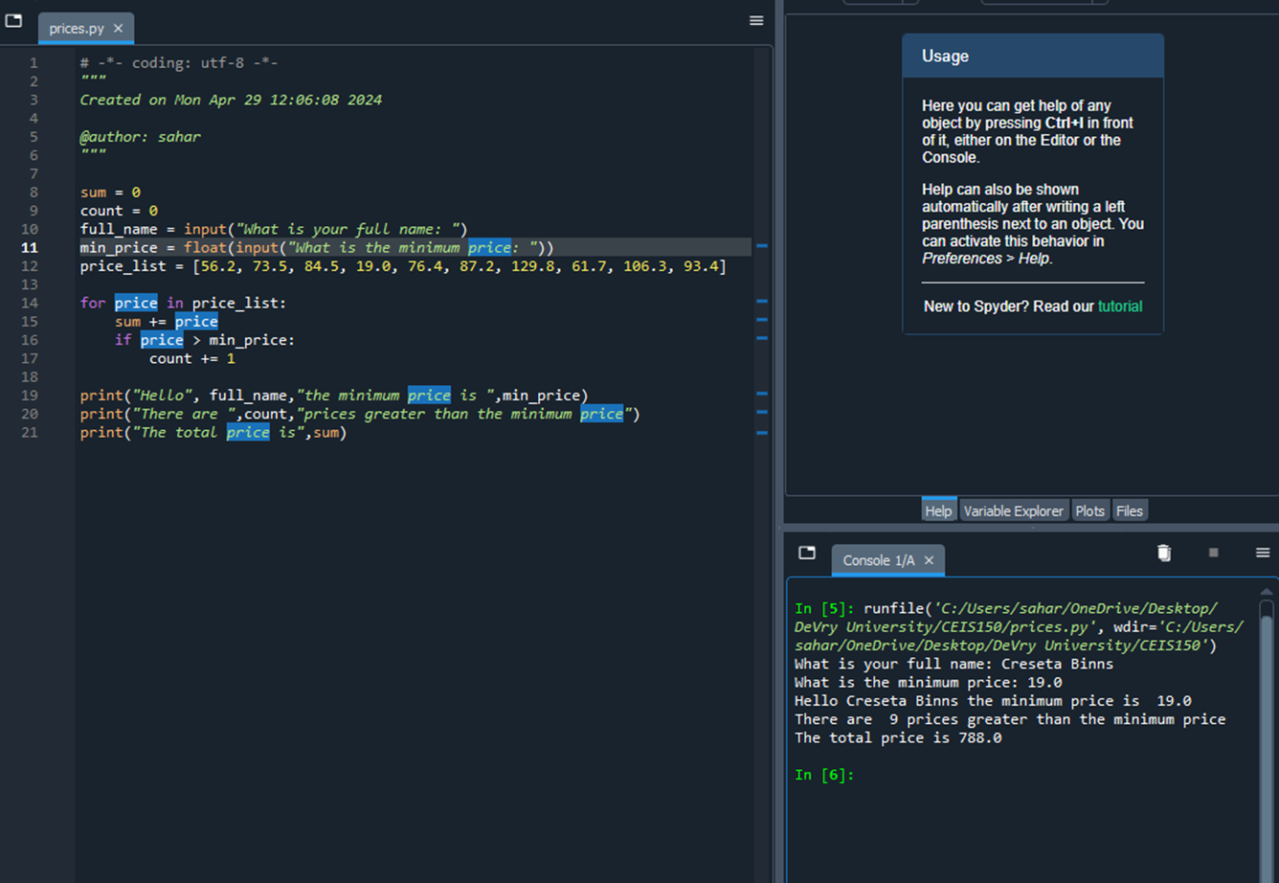
Software Environment Setup
In this part of the project, I focused on setting up the environment used to develop the stock tracking application. I installed Anaconda and chose Spyder as my IDE for my project. Then I created a program using pseudocode that would’ve been provided by a systems analyst.

Slide 4
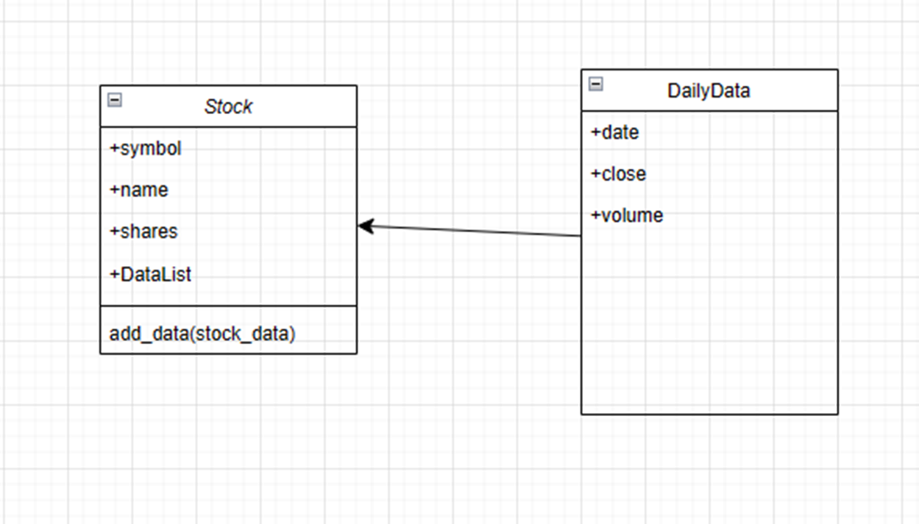
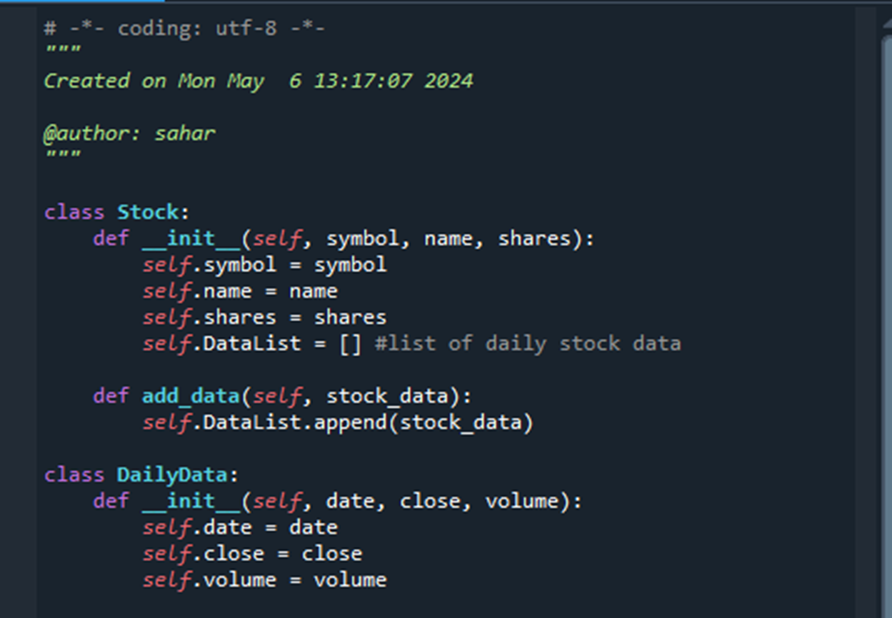
Class Diagrams, Class Coding, & Unit Testing
Visio Class Diagram
Stock Class Code
(stock_class.py file)

Slide 5
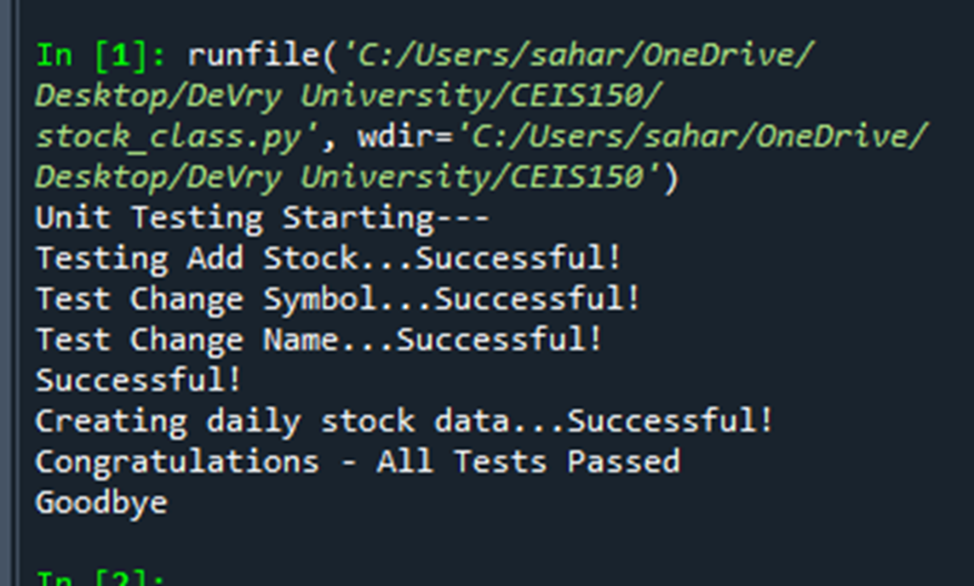
Class Diagrams, Class Coding, & Unit Testing Cont.
Successful Unit Test
The Unit test of Stock Class code was successful. When I ran the file unit test it attempted to create a new stock and add price history to the stock. After all the tests were completed, the test would produce a report showing which test passed or failed, then provide a summary list of errors that need to be fixed.

Slide 6
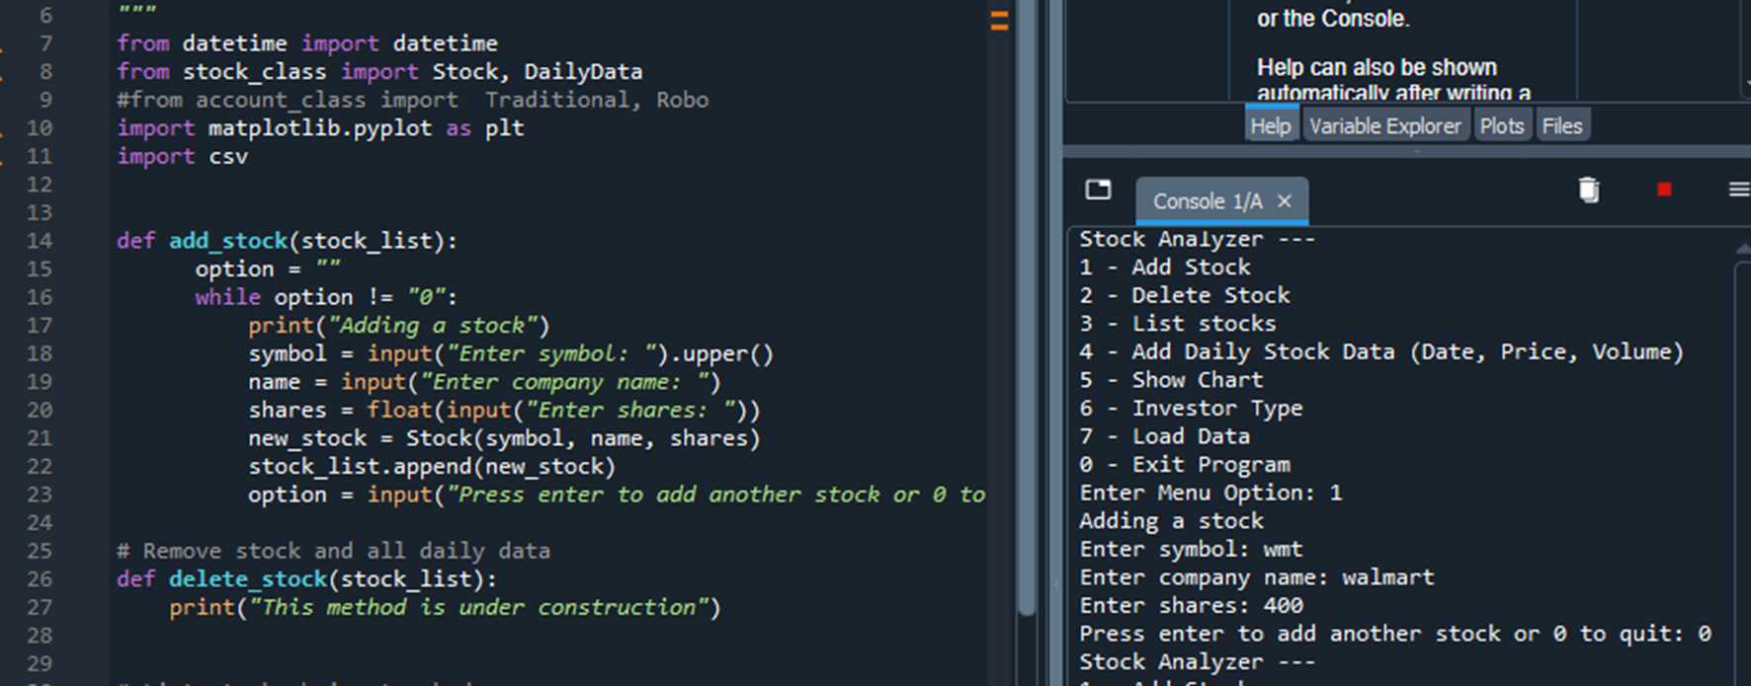
Text-Based User Interface Summary Report
Adding a Stock
In this part of the project, I implemented the (add_stock() ) method. In this method we ask the user for information about the stock they want to add to their portfolio (ticker symbol, company name, and number of shares).

Slide 7
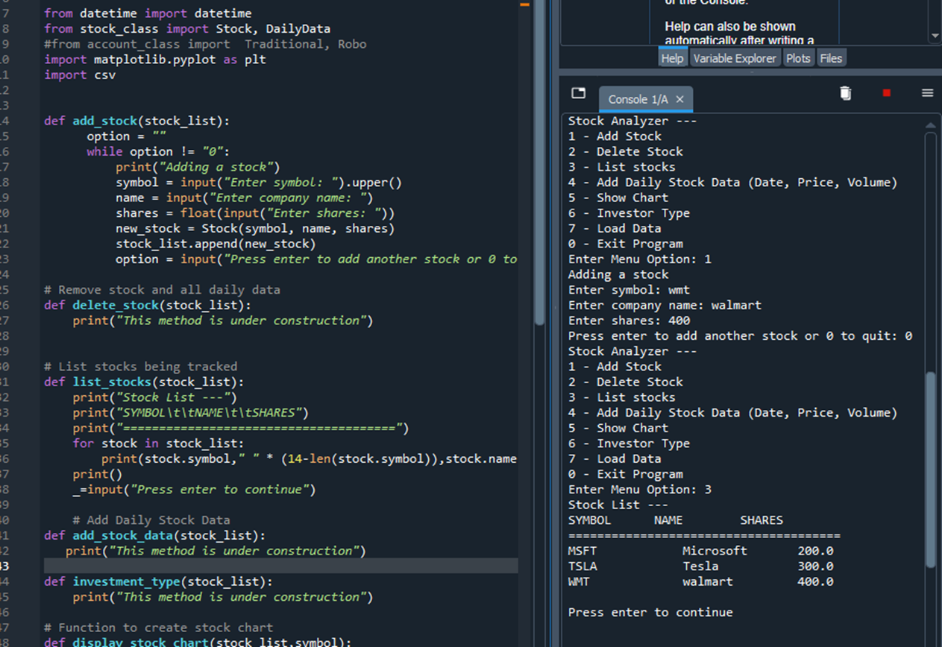
Text-Based User Interface Summary Report Cont.
Listing 3 Stocks
This step of the project will test to make sure the stocks are being entered correctly, now that we can add stocks to the portfolio. Now you will see that the code for the list_stocks() function is implemented so that I can display the stocks entered.

Slide 8
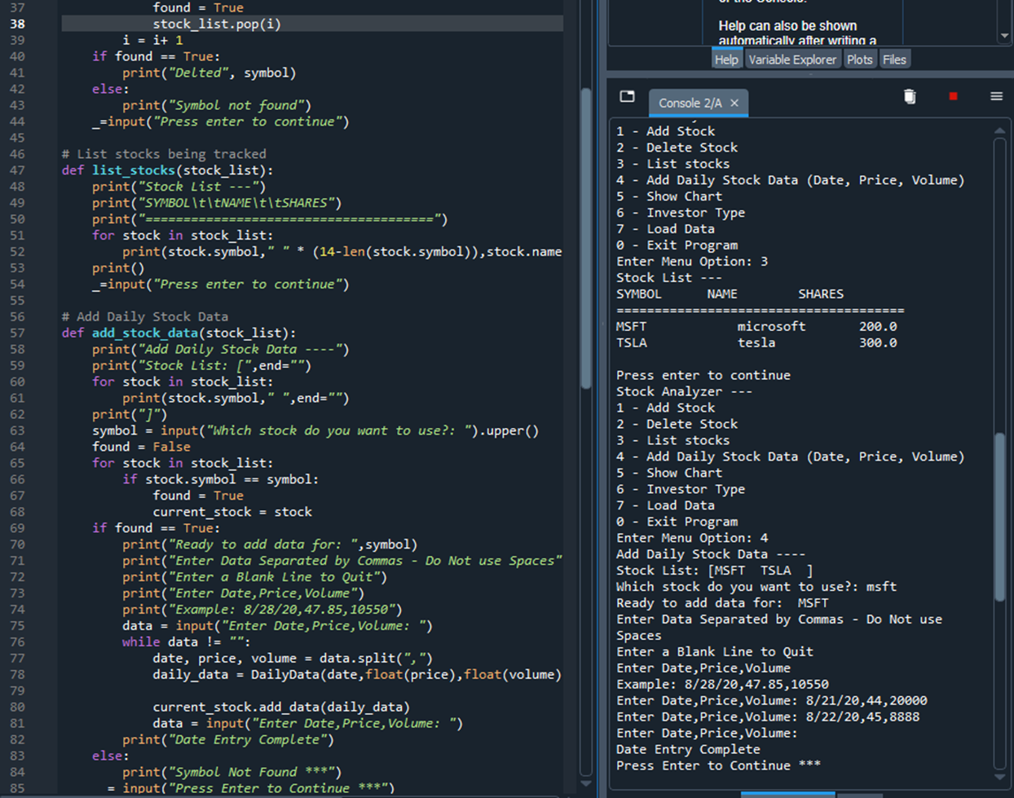
Text-Based User Interface Summary Report Cont.
Daily Data
In this part of the project, I would allow the user to enter historical data for a stock. Once the user enters a stock, I’ll loop through the stock_list to find the stock. Then I’ll ask the user for the date, closing price, and volume. The user will enter this all on one line separated by commas. Now that we have the new DailyData record, we add it to the current stock. I continue to loop through the data until the user enters a blank line to stop the data entry.

Slide 9
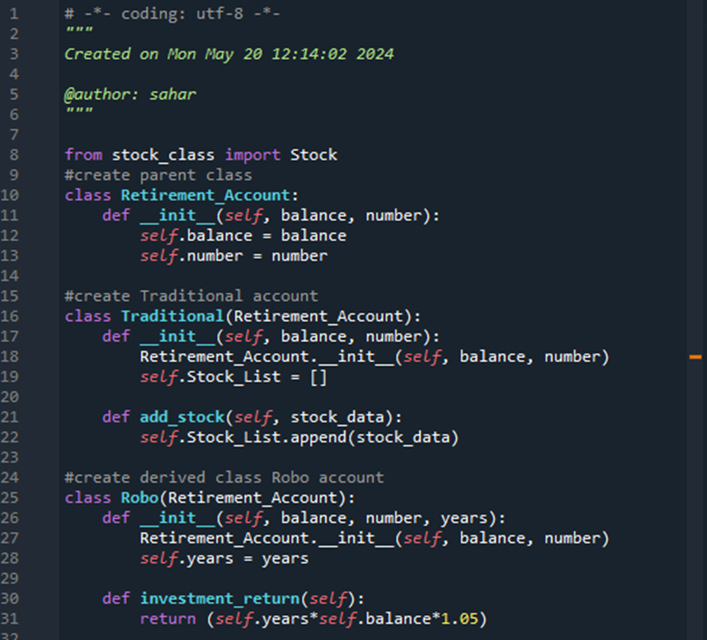
Inheritance Summary Report
Inherited Classes
In this part of the project, I will implement inheritance in the stock program by creating two types of retirement accounts. When investing, you can choose a traditional retirement account or an automatic account. The traditional account will allow you to choose to invest in specific socks. The automatic account (also known as a robo account) will simply invest the account in a fund for a certain number of years.

Slide 10
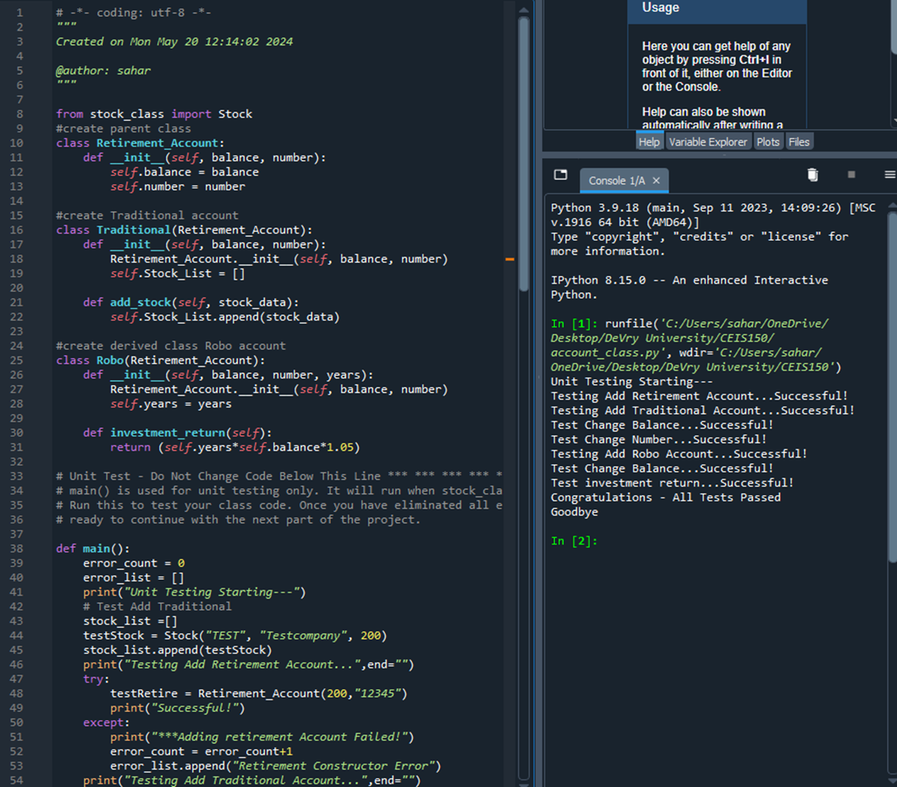
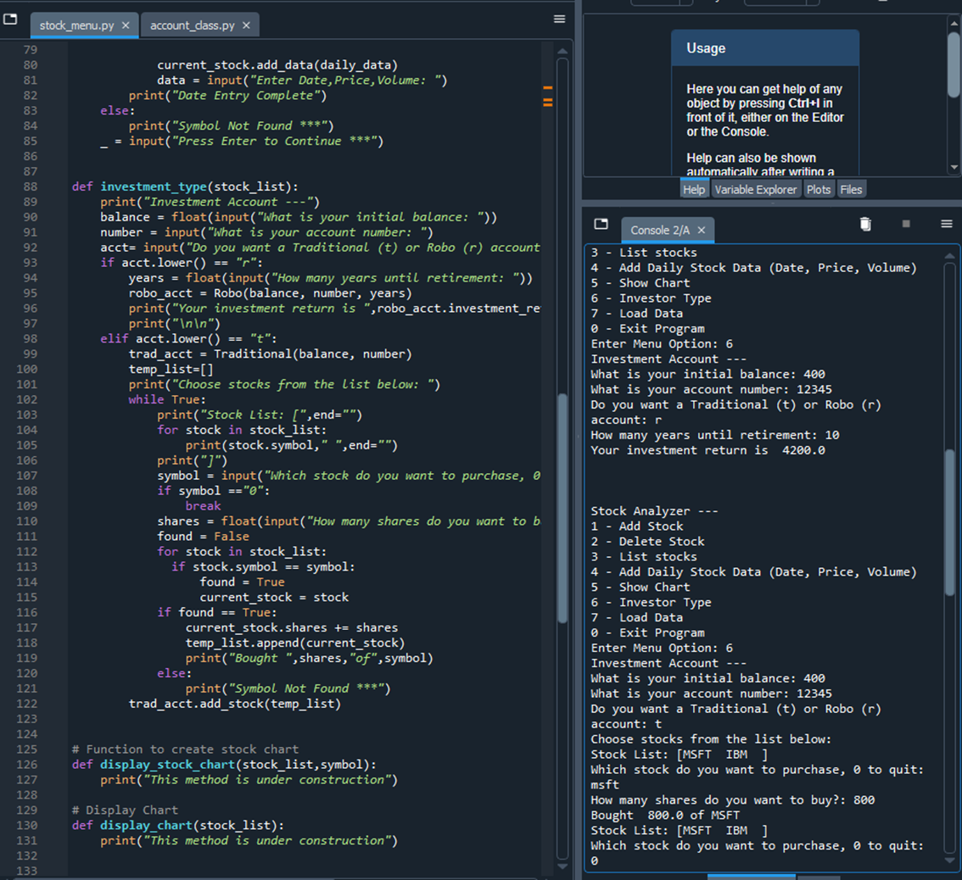
Inheritance Summary Report Cont.
Unit Tests
Classes in Stock Menu Program

Slide 11
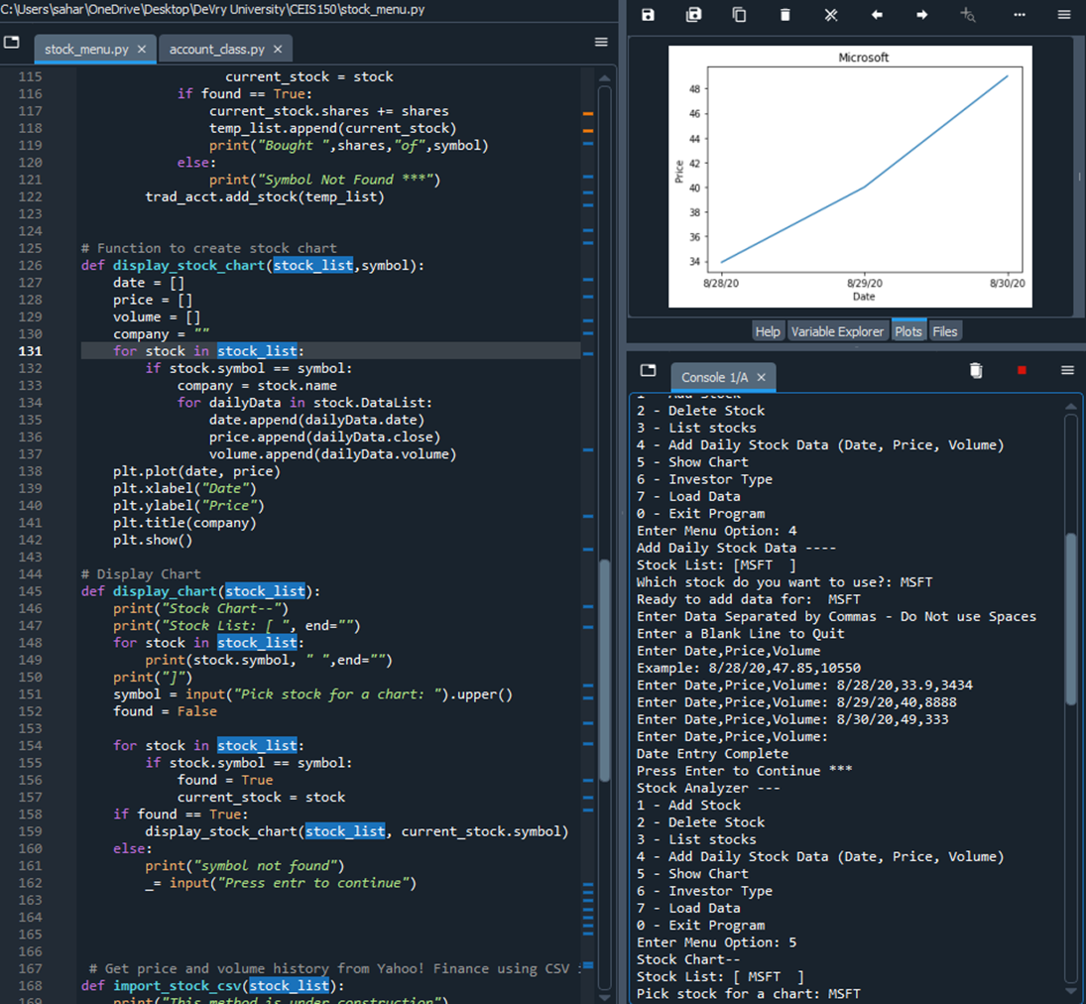
Creating A Chart
Implement display_stock_chart()
In this part of the program, I created a stock chart as a visualization for the stock data. To create the stock chart, I will be using the matplotlib library. This library makes it easy to create many types of visualizations from simple line charts to more complex and interactive graphics.

Slide 12
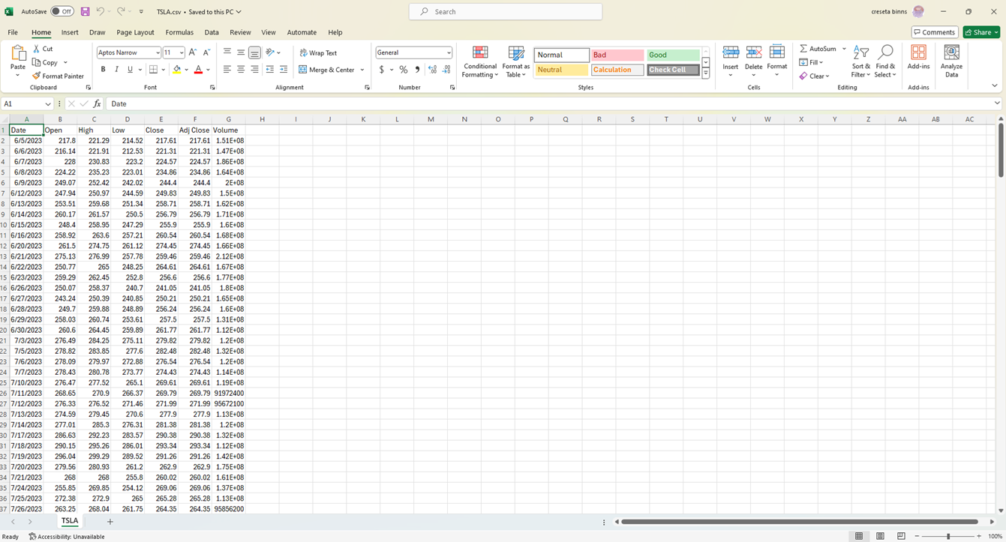
Loading Data
Download Historical Data
In this step I downloaded historical stock data from the Yahoo Finance website that is provided as a downloadable csv file. Then I used the csv library to implement the import functionality

Slide 13
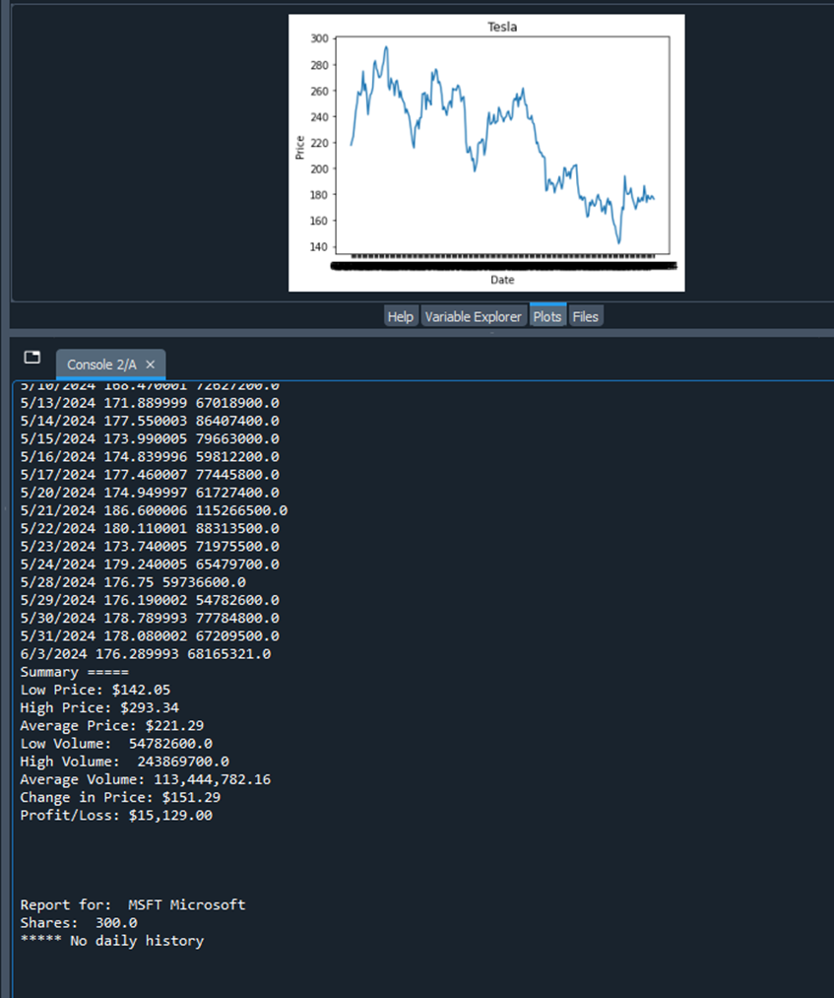
Loading Data Cont.
Historical Data Import
Then we implement the import_stock_csv(), then we implement the display_report(stock_list). Then we test the csv import code and use the same symbol as the data that you saved from Yahoo Finance.

Slide 14
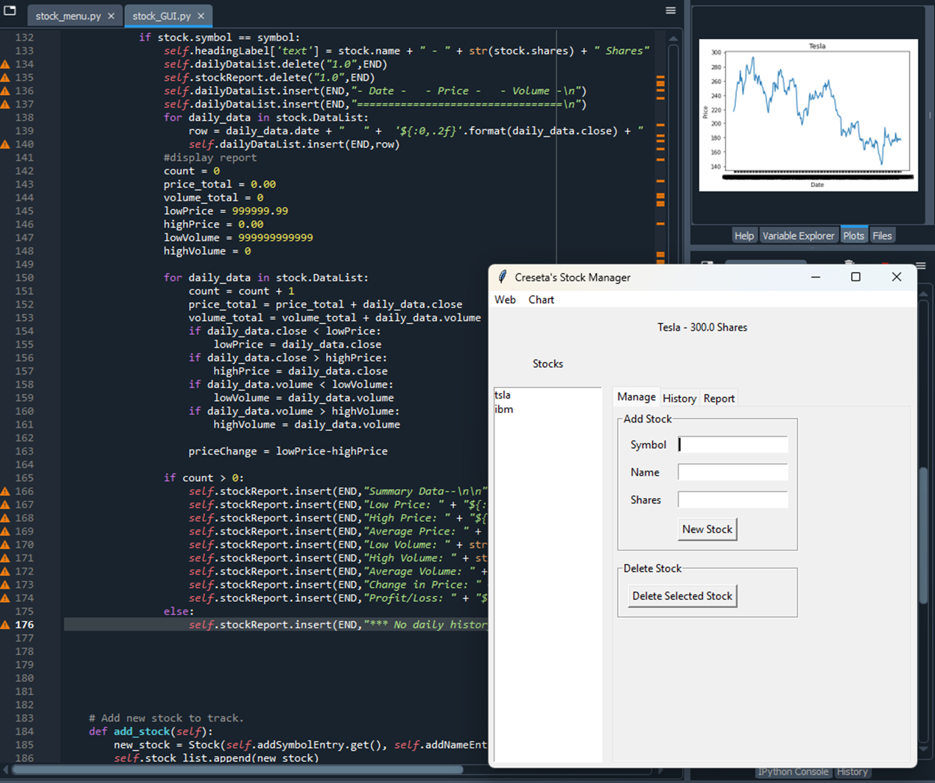
GUI (Graphical User Interfaces)
Created a GUI Interface
In this part of the project, I created a graphical user interface using the tkinter library. One advantage of using tkinter is that it’s a cross-platform interface, which means it can be used on Windows, Linux, and Mac. This shows that the program I wrote to create the GUI works.

Slide 15
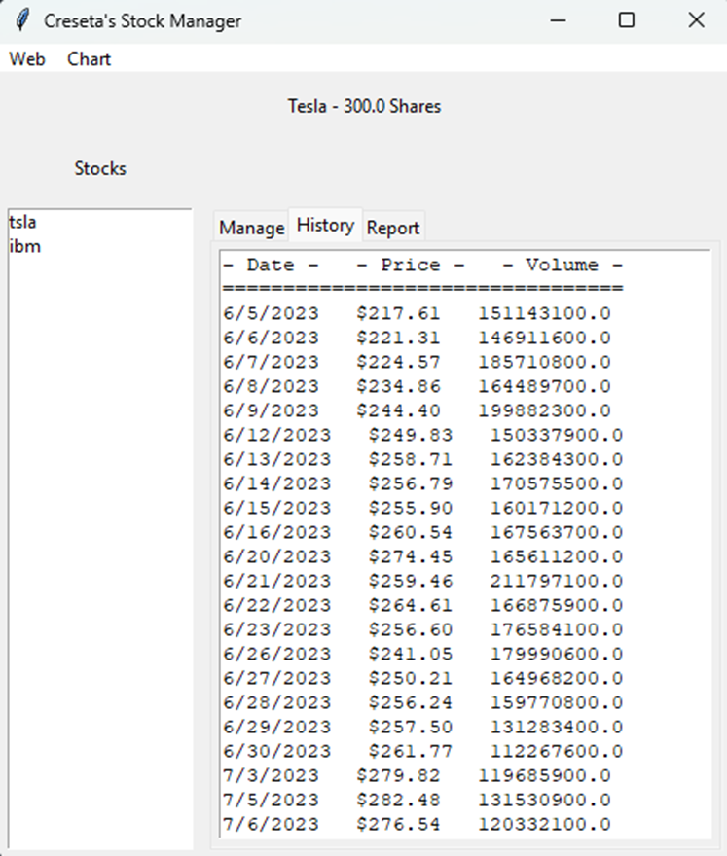
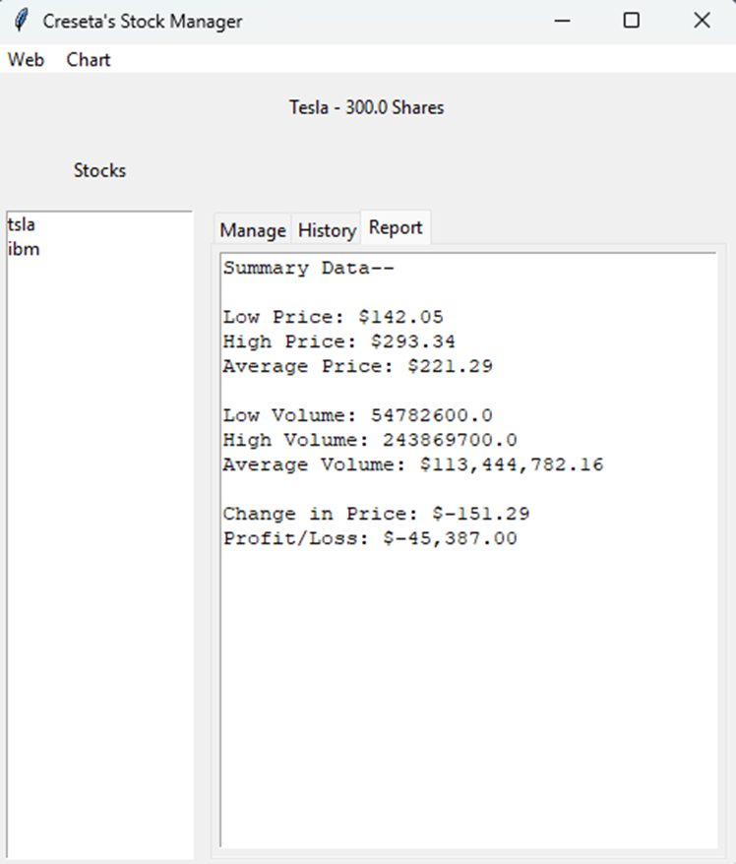
GUI (Graphical User Interfaces) Cont.
GUI History Tab and Import is Working
GUI Report is Completed

Slide 16
Career Skills Developed
Classes and Objects
Encapsulation
Inheritance
Polymorphism
Abstraction
Composition
Interfaces and Abstract Classes
Magic Methods
Unit Testing
Problem Solving

Slide 17
Conclusion
Through my successful completion of this project, I was able to demonstrate the practical application of Python object-oriented programming in financial analysis and investment tracking. I achieved several key objectives throughout this project: data collection and integration, data analysis, visualization, and user interface. This project gave me a deeper understanding of Python programming, financial markets, and data analysis techniques.

