Slide 1
CEIS106 Introduction to Operating Systems
Creseta Binns

Slide 2
Introduction
This project shows how to utilize the Linux filesystem hierarchy, shell scripts, management of users and groups, network configurations, and system performance monitoring.

Slide 3
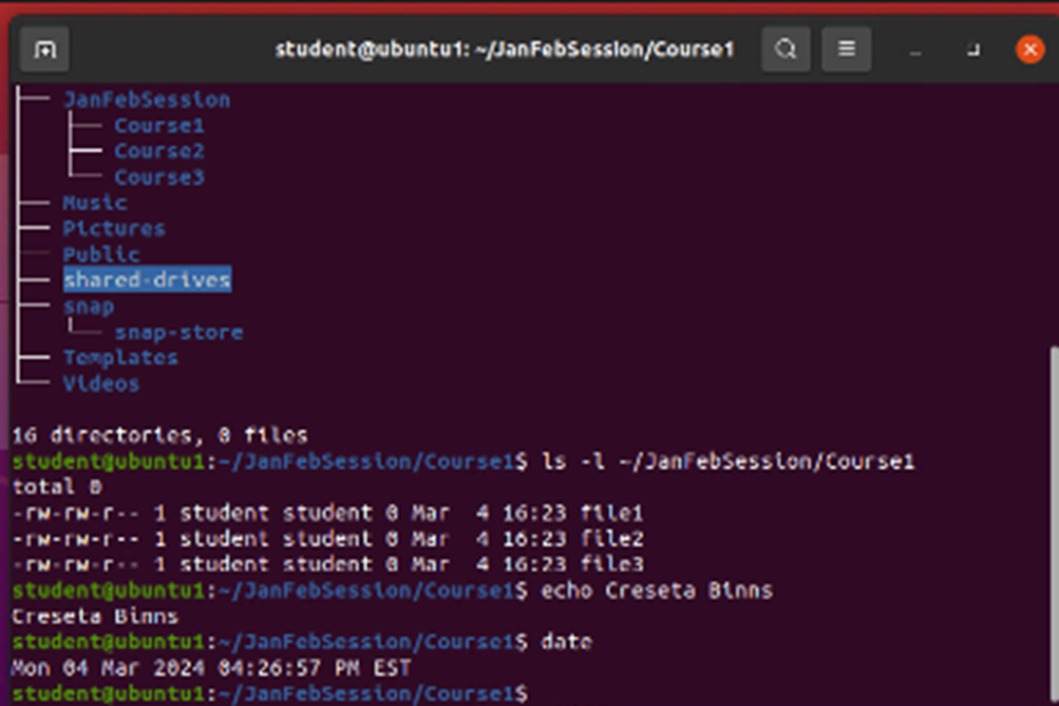
Linux Filesystem Hierarchy
1. What is the pwd command an acronym for? What about the cd command?
Answer here: The pwd command is an acronym for print working directory which shows the path of the current directory.
The cd command is an acronym for change directory which changes over to the directory that you specify.
2. Explain the differences between a relative path and an absolute/full path in Linux.
Answer here: Relative path – path based on your current location
Absolute path – path starting from the very top of the filesystem, which is the root -- /

Slide 4
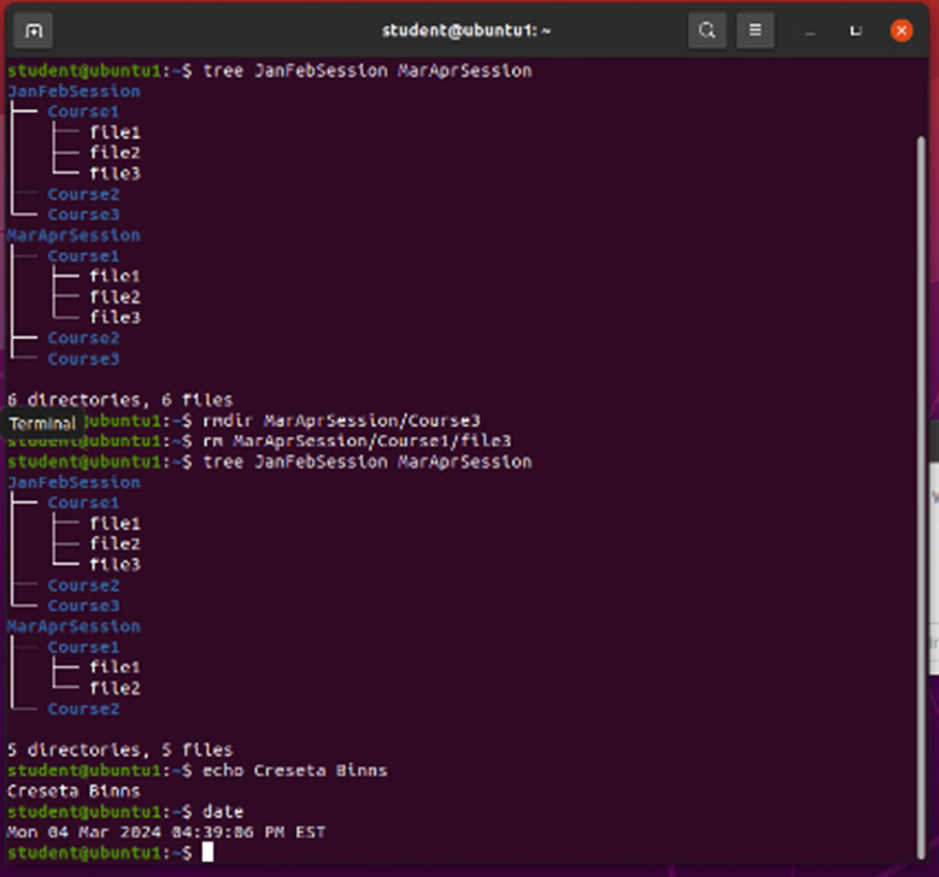
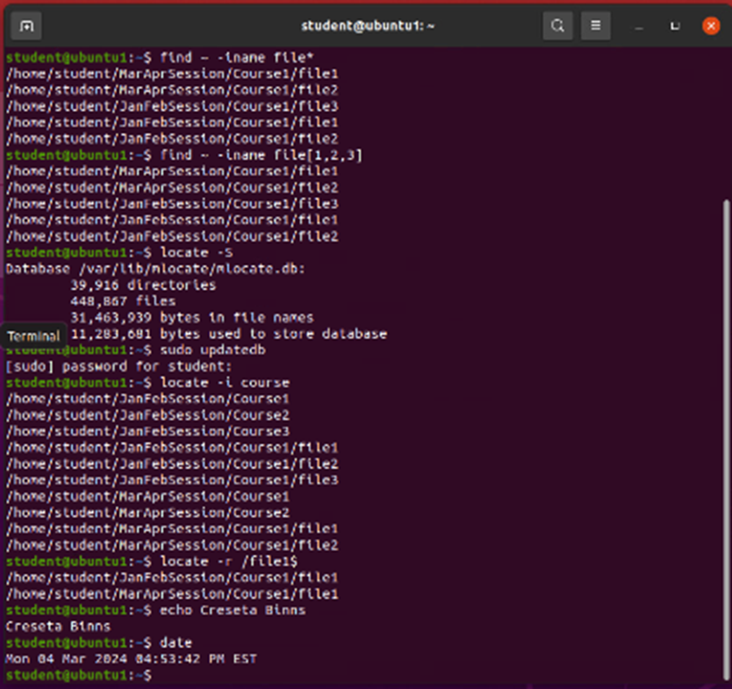
Linux Filesystem Hierarchy (cont.)
Copy & Remove Directories & Files
Locate Directories & Files

Slide 5
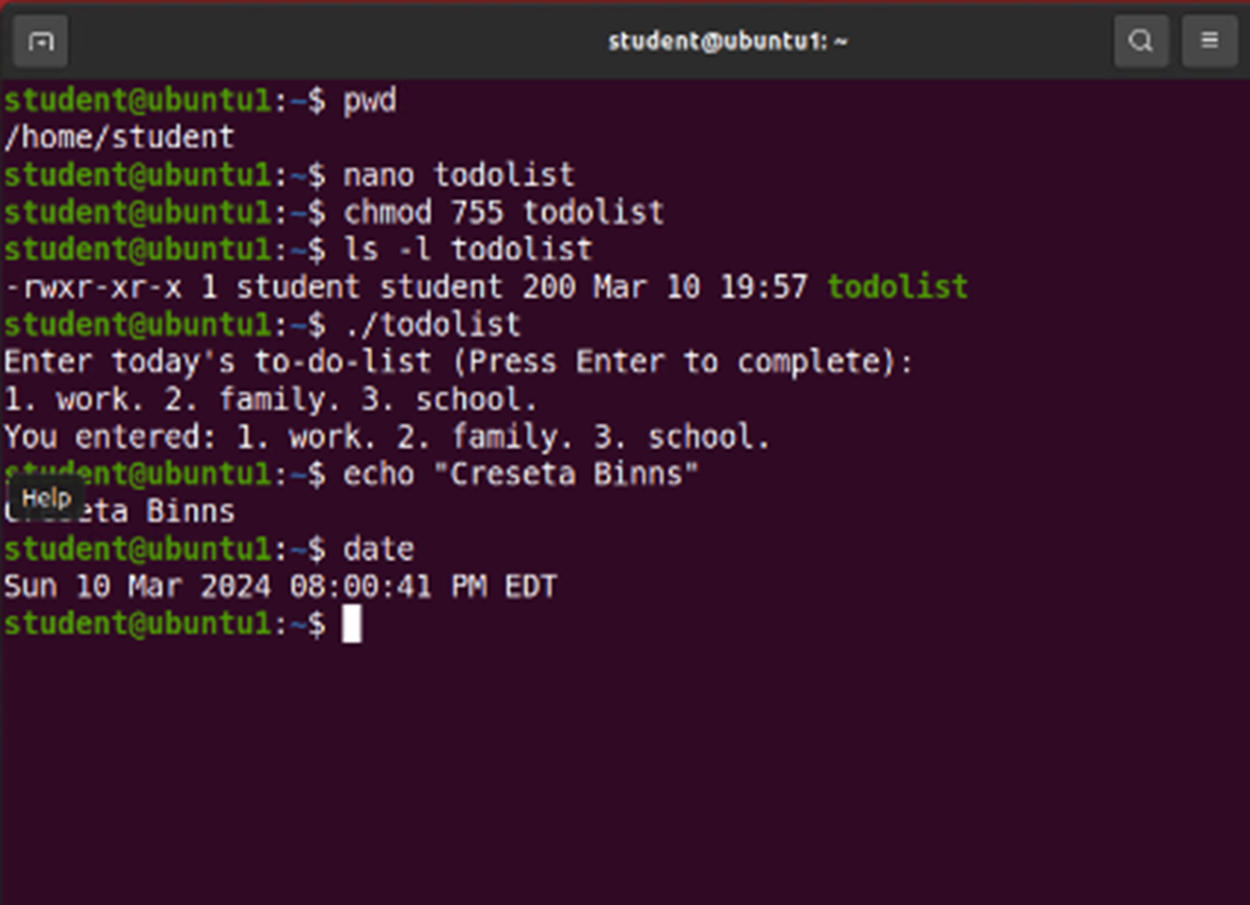
Linux Shell Scripts
1. What are the file permissions of the script?
Answer here: rw- rw- r-- --read/write for the owner, read/write for the group, and read only for everyone.
2. What’s the name of the user-defined variable in the script?
Answer here: text
3. Which redirection meta-character is used in the script? What does it do?
Answer here: >> -- redirection to the file and appends to the end of the file
Change Script File Permissions

Slide 6
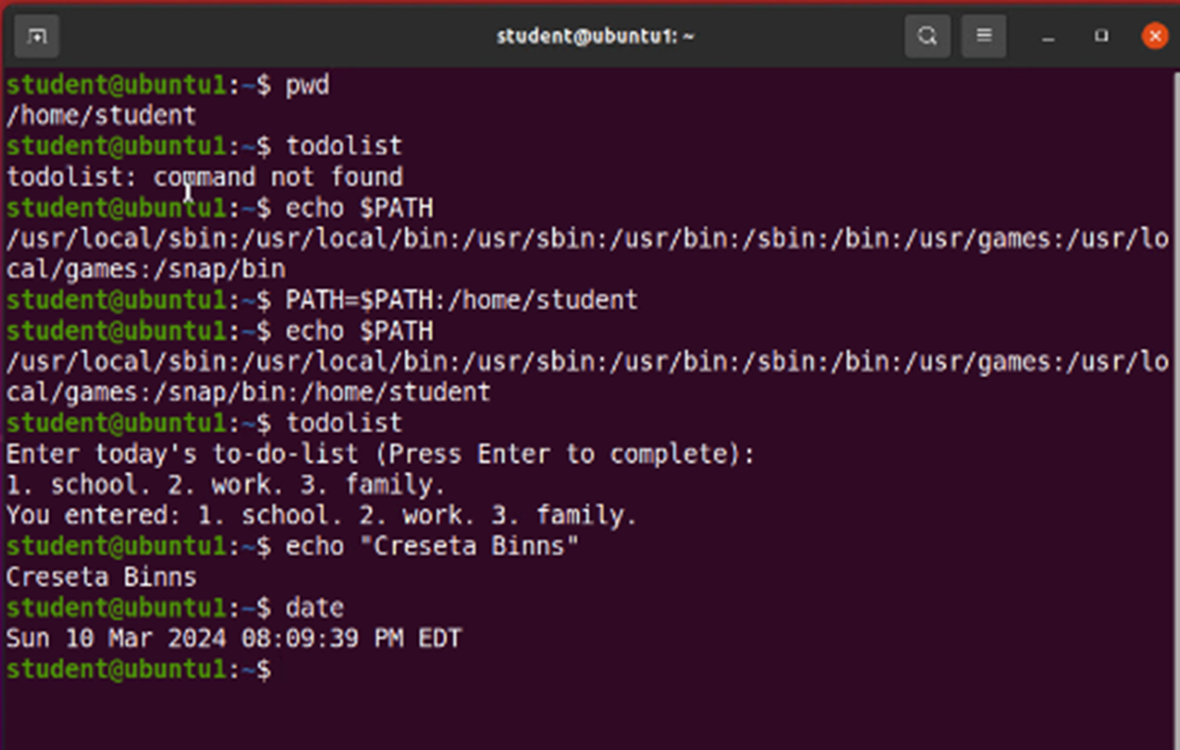
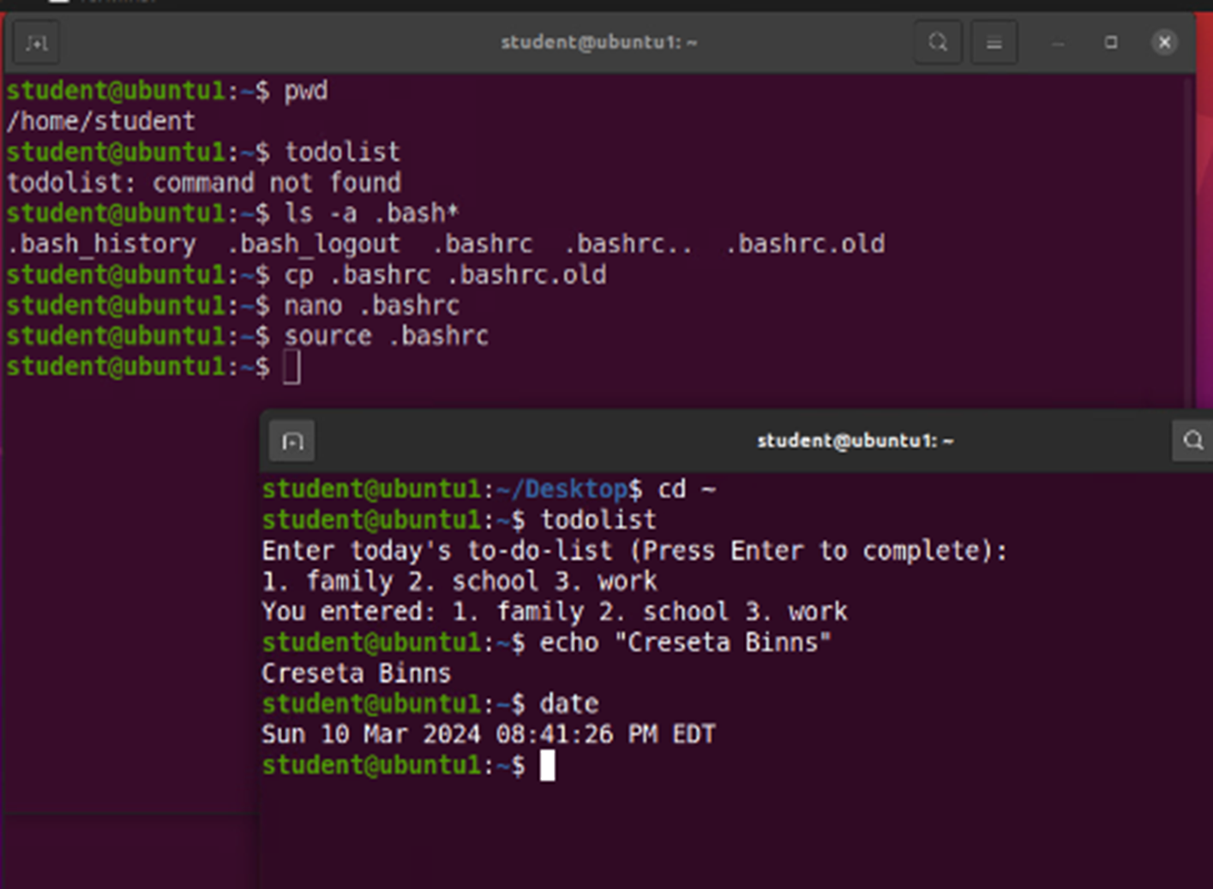
Linux Shell Scripts (cont.)
Make the PATH Variable Permanent
Set the PATH Variable

Slide 7
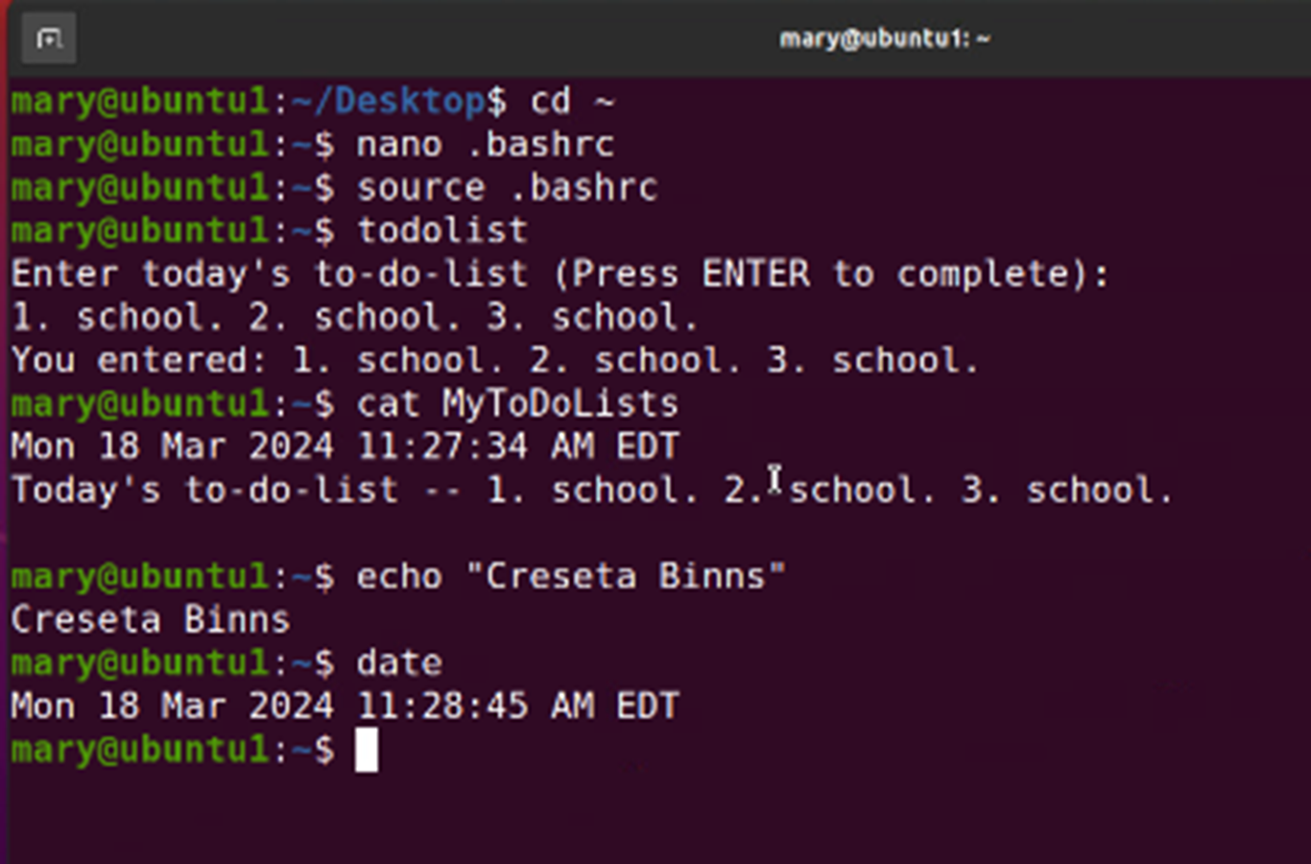
Linux User and Group Management
Add Users and Groups in CLI
Test User and Group Settings
1. What does the –m option in the useradd command do?
Answer here: -m –tells useradd command to create a home directory for this new user
2. What does the -3 option in the tail command do?
Answer here: -3 –tells tail command how many lines to show from the end of the file
3. Which line of the /etc/group file lists members of the “students” group? Copy it here.
Answer here:

Slide 8
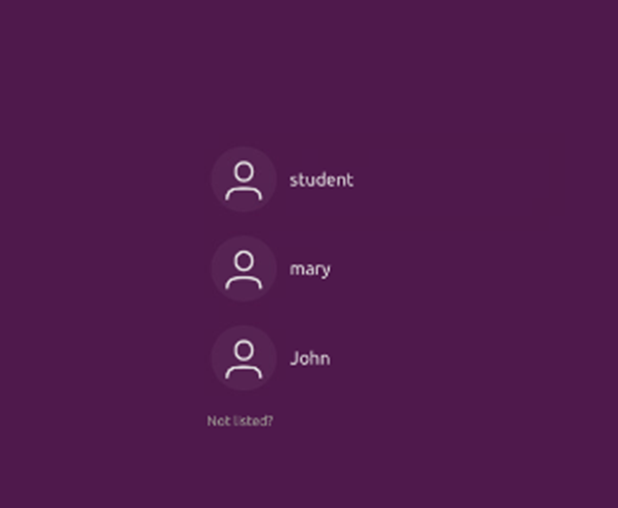
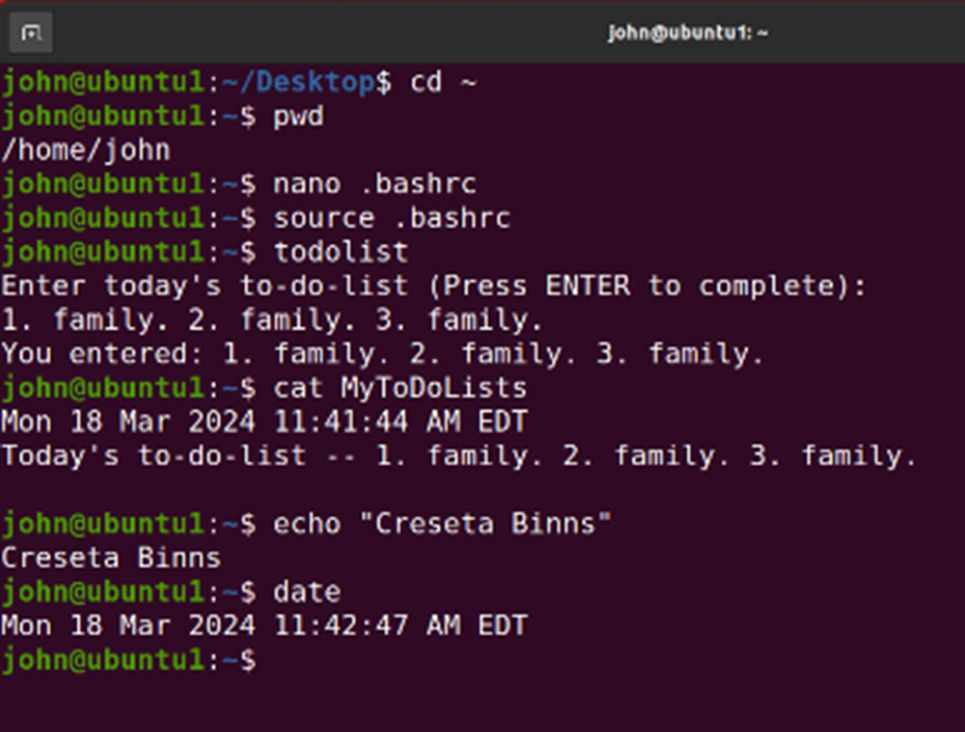
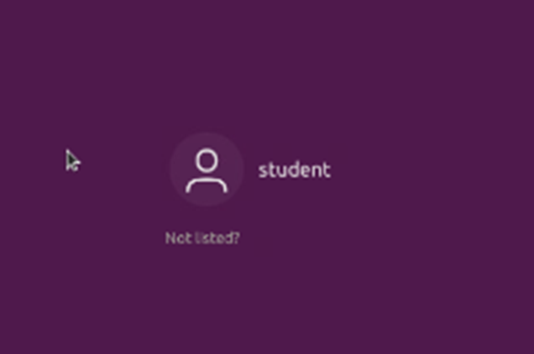
Linux User and Group Management (cont.)
Add Users in GUI
Remove Users and Groups

Slide 9
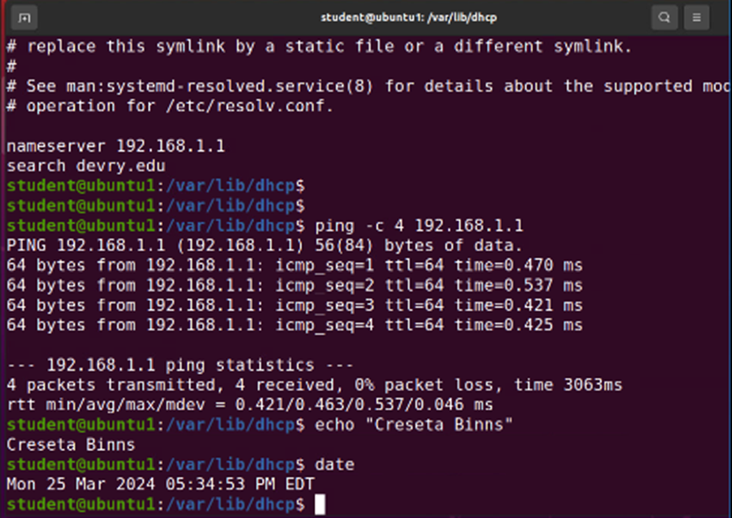
Linux Network Configuration
Discover Host IP Configurations
1. What is the IP address of your Ubuntu machine?
Answer here: 192.168.1.107
2. What is the IP address of its default gateway?
Answer here: 192.168.1.1
3. What is the IP address of its DHCP server?
Answer here: 192.168.1.1
4. What is the IP address of its DNS server?
Answer here: 192.168.1.1

Slide 10
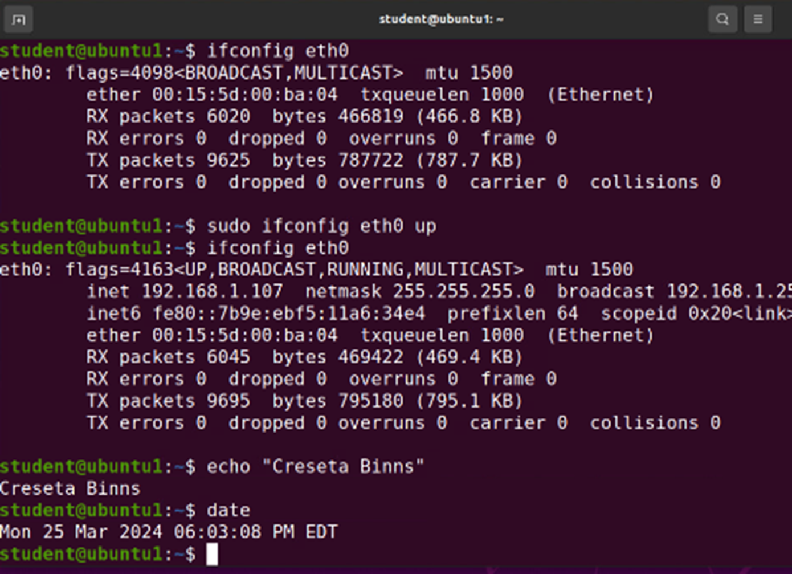
Linux Network Configuration (cont.)
Manage Network Interfaces
Use Network Utilities
1. Which DHCP message is shown in the output of the sudo dhclient –v –r ens33 command?
Answer here: DHCPRELEASE
2. Which four DHCP messages are shown in the output of the sudo dhclient –v ens33 command?
Answer here:
DHCPDISCOVER
DHCPOFFER
DHCPREQUEST
DHCPACK

Slide 11
Linux System Performance Monitoring
Monitor Linux Processes
Monitor User Activities
1. What is the default action of the 15 SIGTERM kill signal?
Answer here: Kill the highlighted process
2. In the System Monitor window, click on % CPU to sort the processes by CPU load. Which process shows the highest percentage of CPU usage?
Answer here: gnome-shell (GUI)
1. What flag value is displayed in the output?
Answer here: S – “super user”
2. Why is the name of the user who ran the processes shown as root, not student?
Answer here: superuser – since we typed sudo in front of the command

Slide 12
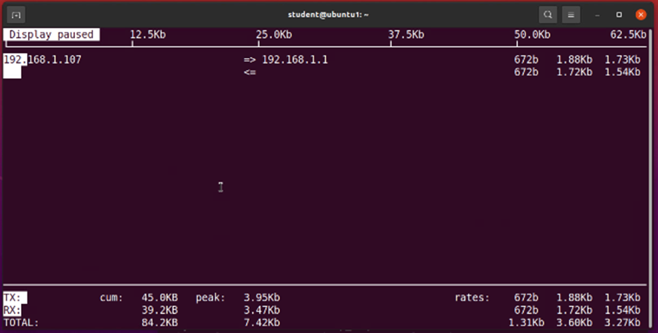
Linux System Performance Monitoring (cont.)
Monitor Network Bandwidth Usage

Slide 13
My Challenges
One of the challenges I had while doing this project was making sure that the password was input correctly and making sure I didn’t miss a character while inputting commands in ubuntu terminal.

Slide 14
Career Skills
Several career skills gained in this project
  Command Line Basics
  Scripting and Automation
  System Administration
  Networking and Version Control
  Security
  Virtualization and Containers
  Text Processing

Slide 15
Conclusion
This project taught me the fundamentals of how to utilize the Linux filesystem hierarchy, shell scripts, management of users and groups, network configurations, and system performance monitoring.
This project provided a hands-on learning opportunity to put into practice the topics covered in the course.

Slide 16
References
The project deliverable videos in each week

