Slide 1
CEIS110 Programming with dAta
Creseta binns

Slide 2
Introduction
Data is growing exponentially.
This project uses a cloud-based system to gather temperature and humidity data.
Then the data is analyzed using programming and data analytics.

Slide 3
Software inventory
Before developing this programming with data project, all software must be downloaded and installed.
Software needed included Excel and python

Slide 4
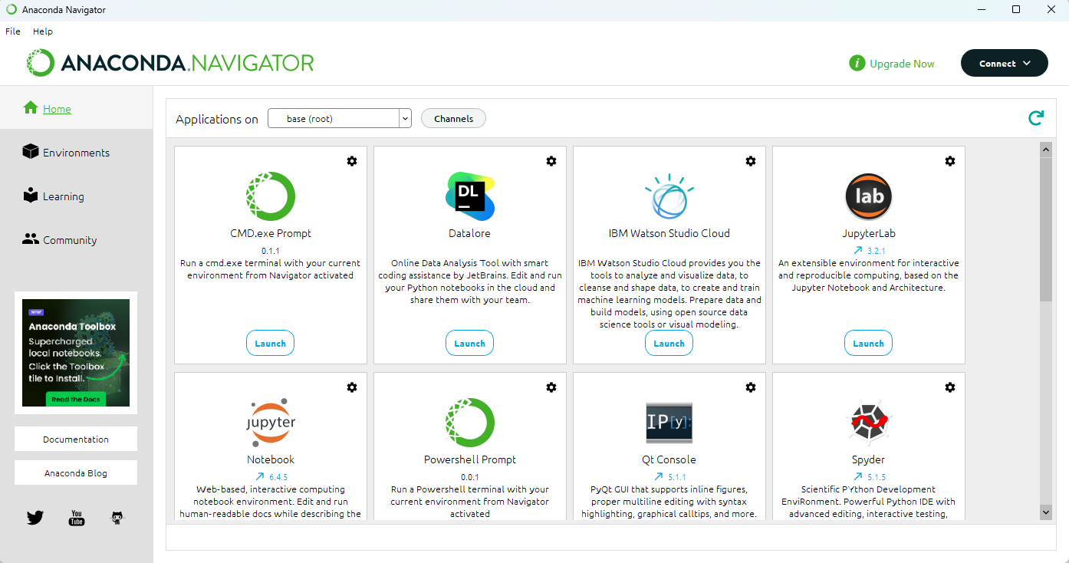
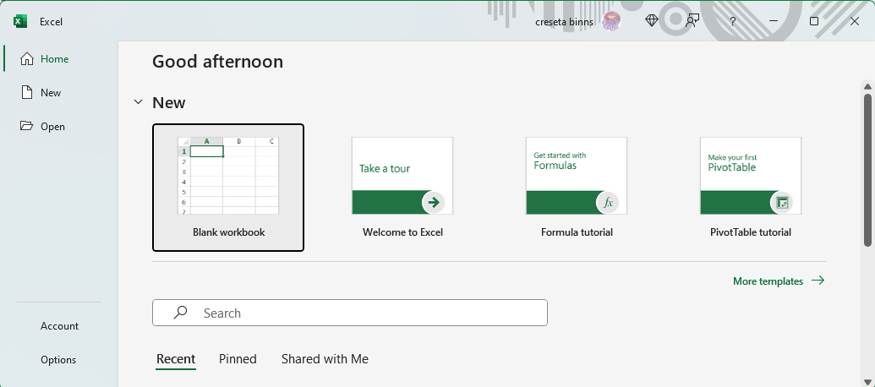
SOFTWARE
The software needed for this project includes:
Microsoft Excel
Anaconda Navigator with Spyder and Replit

Slide 5

Planning and design
After performing an inventory of the software needed for the project, a plan was created for the temperature data project.
To plan the design of the project, a flowchart was generated.
Planning and design of the project are crucial steps to understanding the development process

Slide 6
What are flowcharts?
A flowchart is a diagram that depicts a process, system, or computer algorithm. It is used in multiple fields to document, plan, improve, and communicate often complex processes in clear, easy-to-understand diagrams.
Many companies use flowcharts as simple narratives.

Slide 7
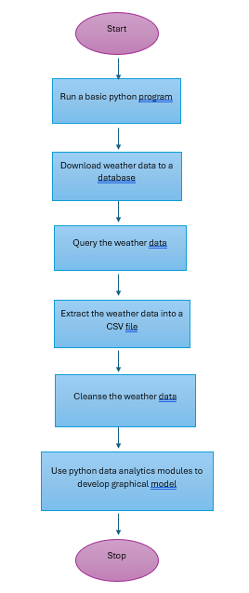
Flowchart
  Run a basic python program
  Download weather data to a database.
  Query the weather data
  Extract weather data from database into a comma separated file with python
  Cleanse weather data
  Use python data analytics modules to develop graphical models

Slide 8
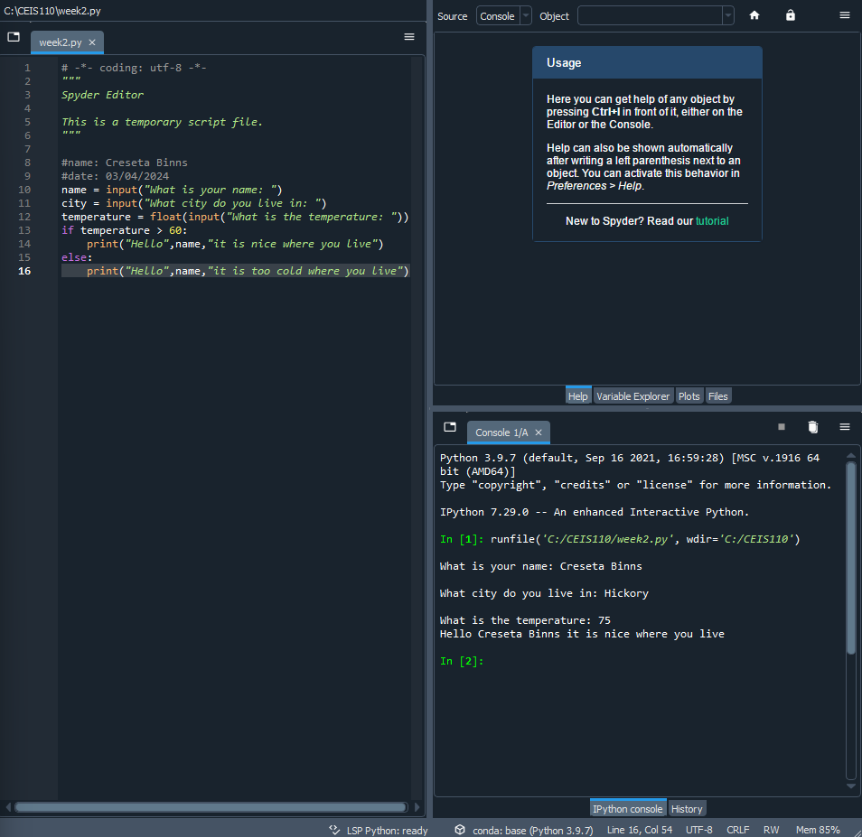
Introduction to python
Python is a popular programming language used for business, web, data analytics, and scientific analysis. This program illustrates a selection control structure in python.

Slide 9
Gathering temperature and humidity data
After planning and design, the code was developed to download a set of weather observations.
This data was stored on a local database in a table for later analysis.

Slide 10
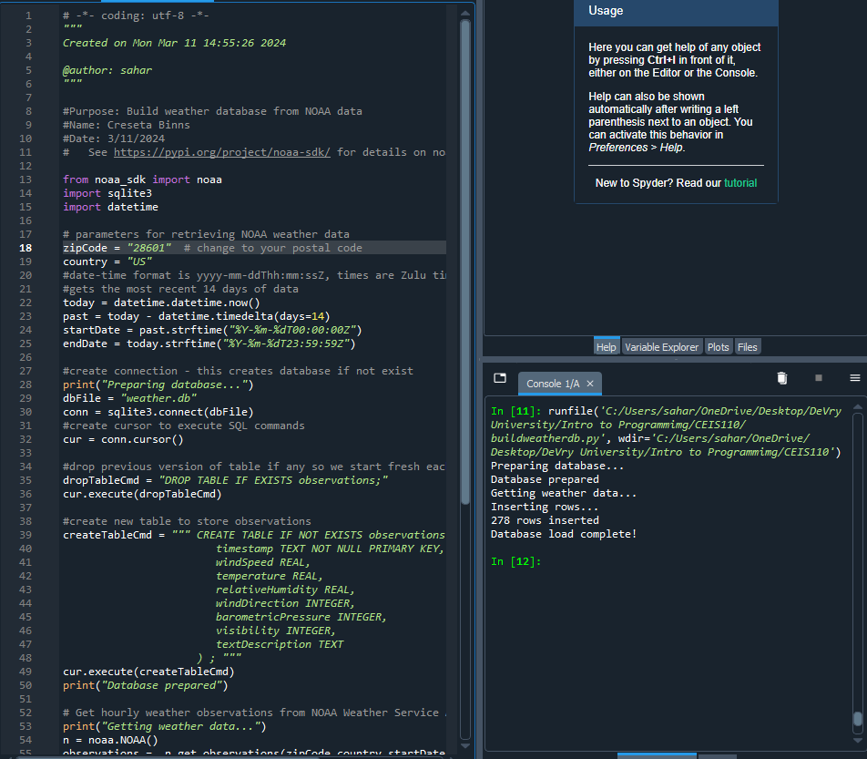
BuildWeatherDb.py Code (Screenshot)
Screenshot of code in Spyder
The code will create a table named Observations with fields: timestamp, windspeed, temperature, relativeHumidity, windDirection, barometricPressure, visibility, and textDescription.
The database will be named weather.db and stored in the same directory as the python code.

Slide 11
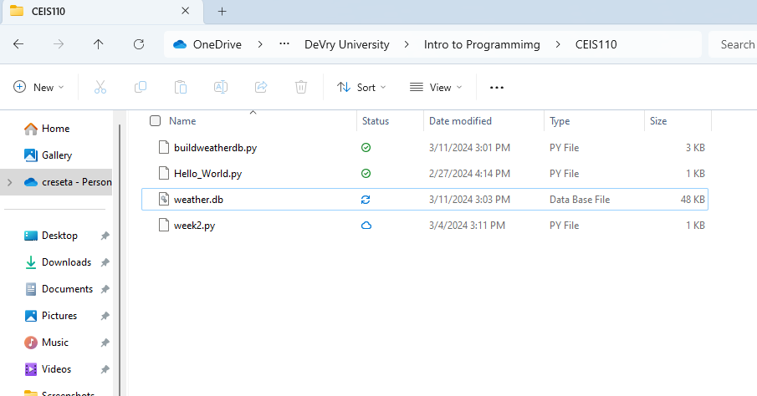
Weather.db file (screenshot)
Screenshot of Windows Explorer showing database file Weather.db was created.

Slide 12
Querying the database
Structured Query Language (SQL) is a programming language used for working with relational databases.
SQL was used to query the database and view the results.

Slide 13
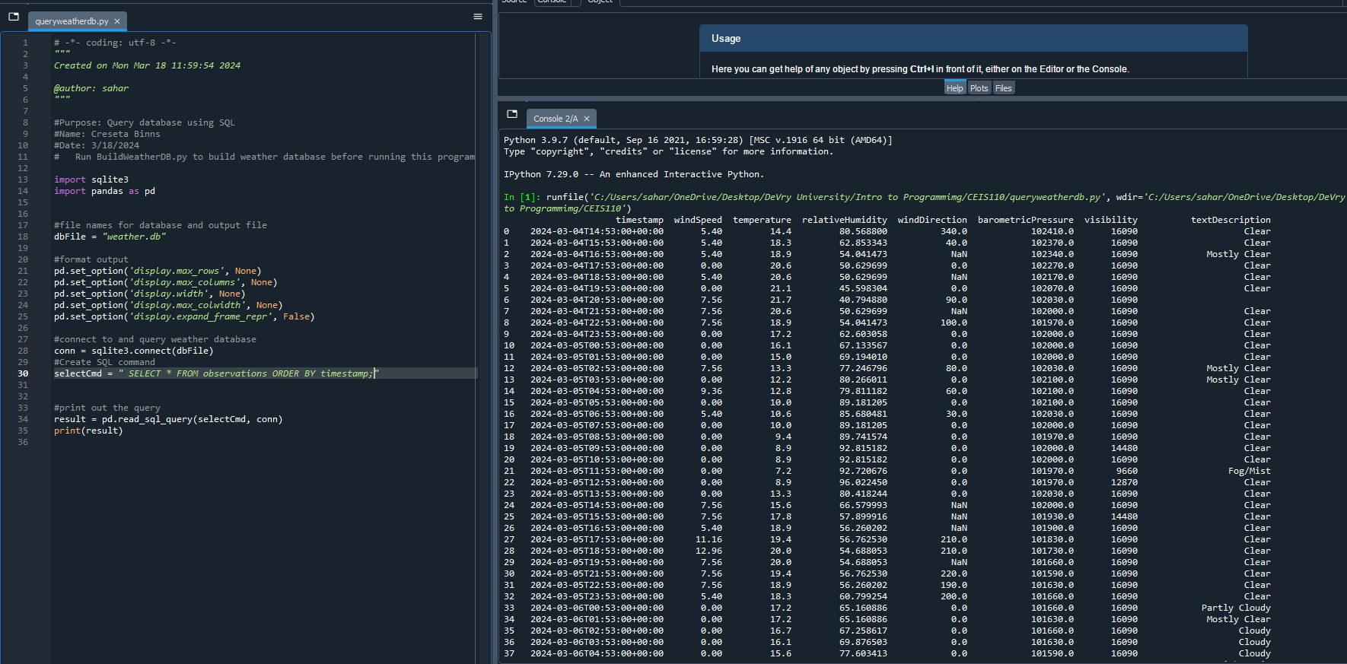
Query to retrieve all columns and all rows (Screenshot)
The SQL command “select * from observations” was executed to retrieve all rows and columns from the observations table.

Slide 14
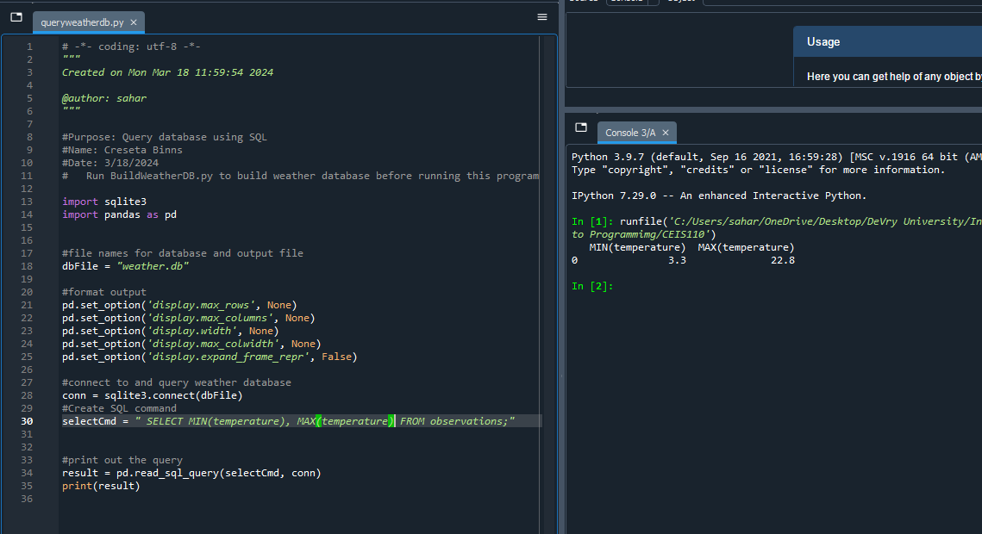
Query to retrieve the lowest and highest temperatures (screenshot)
The min and max temperature were retrieved. These temperatures are captured based on the Celsius scale.

Slide 15
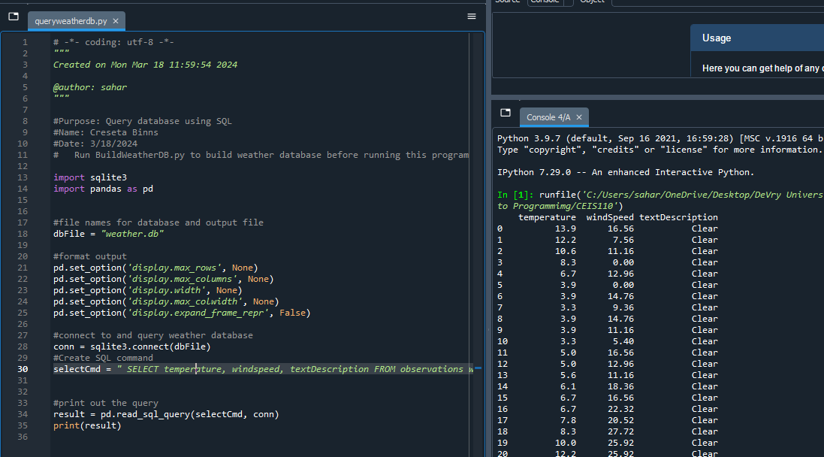
Query to retrieve the data when the weather is clear (screenshot)
Another query was performed to retrieve the temperature, windspeed, and textdescription when the weather is clear.

Slide 16
Data cleansing
Data output from machines may have errors or extraneous data. When cleansing the data, programs can automatically put it in the format needed to be read by other programs.
A python program is reading in the data output by the python program and saving it in a csv file so that it can be read by Excel.
Often data must be cleansed of spurious or missing values in a dataset. The data must be complete, valid, and standardized.

Slide 17
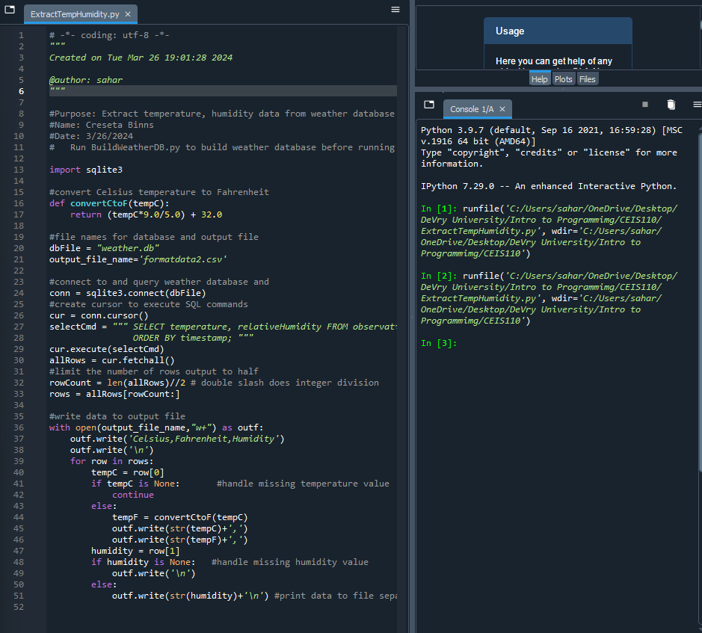
Extracting temperature and humidity using python code
The weather.db database may contain null or missing values. The code used retrieves only the temperature and humidity values and writes them to a comma separated values (CSV) file. Two files are created – a formatdata.csv and a formatdata2.csv that each contain half of the rows. Missing and invalid values are not written to the file.

Slide 18
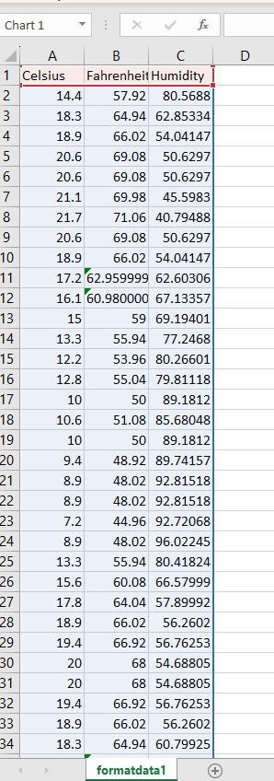
Data formatted in an excel spreadsheet
The python program created a formatdata.csv file
This file contains 3 columns: Celsius, Fahrenheit, and Humidity
Statistics can be performed on this spreadsheet

Slide 19
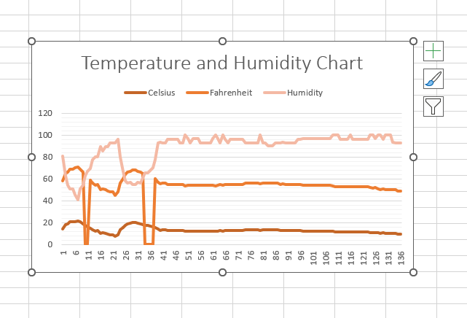
Data visualization
A line chart was developed in Excel showing the Temperature and Humidity over Period 1

Slide 20
Data analytics
Python Data analytics module allows users to develop charts and graphs depicting data
The data sets can be manipulated as well and saved into tabular format
The data analytics module are available as part of Anaconda
Several plots were generated looking at humidity and temperature
Then a prediction was made about the data

Slide 21
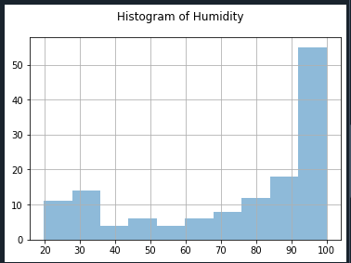
Histogram of humidity
#Purpose: Create a histogram of humidity data from the second week
#Name: Your name
#Date: Your date
import pandas as pd
import matplotlib.pyplot as plt
df1 = pd.read_csv("formatdata1.csv")
df2 = pd.read_csv("formatdata2.csv")
df2['Humidity'].hist(bins=10, alpha=0.5); plt.suptitle('Histogram of Humidity')
plt.show()

Slide 22
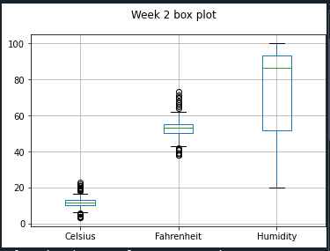
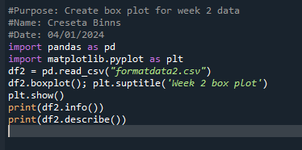
Period 2 box plot

Slide 23
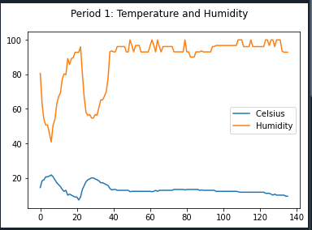
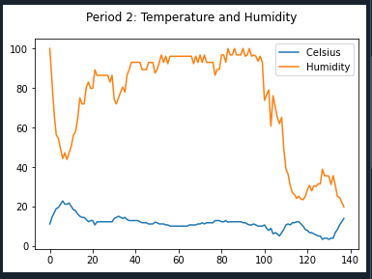
Analysis
The next step in analysis is developing a question and reviewing the data to answer the question. A chart can be used to look at the data
My question: BY looking at Period 1 and 2, can you predict if the temperature and humidity for the following week will be higher or lower?
I created 2 line plots, one for each period. Using both period 1 line plot and period 2 line plot, you can make a better prediction of what the weather will be like in the following week.

Slide 24
code
The code to create the Celsius and Humidity line plots for Period 1 and 2
#Purpose: Create Period 1 plot comparing Temperature and Humidity
#Name: Creseta Binns
#Date: 04/01/2024
import pandas as pd
import matplotlib.pyplot as plt
df1 = pd.read_csv("formatdata1.csv") #baseline data is period 1 (older)
df1 = pd.read_csv("formatdata1.csv") #baseline data is period 1 (older)
plt.figure(); df1.Celsius.plot(label = 'Celsius '); df1.Humidity.plot(label = 'Humidity'); plt.legend(loc='best'); plt.suptitle('Period 1: Temperature and Humidity')
plt.show()

Slide 25
Code (continued)
#Purpose: Create Period 2 plot comparing Temperature and Humidity
#Name: Creseta Binns
#Date: 04/01/2024
import pandas as pd
import matplotlib.pyplot as plt
df2 = pd.read_csv("formatdata2.csv") #data for period 2 (more recent)
df2 = pd.read_csv("formatdata2.csv") #data for period 2 (more recent)
plt.figure(); df2.Celsius.plot(label = 'Celsius '); df2.Humidity.plot(label = 'Humidity'); plt.legend(loc='best'); plt.suptitle('Period 2: Temperature and Humidity')
plt.show()

Slide 26
prediction
According to the weather data collected for where I live, I believe that the temperature is going to continue to rise and so will the humidity. The rise in humidity will also result in some rain showers passing through my city. Since humidity rises when the temperature rises, that means that the humidity will drop when the temperature drops. Because we are in spring, I’m confident we will still have some cool days which will result in lower humidity. Overall, the temperature will continue to rise which will contribute to a rise in humidity.

Slide 27
My challenges
When creating the python program, I saved the program in the wrong directory, which was supposed to be in the same directory as weather.db
I had misspelled a word in the code which gave me a syntax error

Slide 28
Career skills
Several career skills gained in this project:
  Communication – Using flowcharts to depict the plan of a project
  Database development
  Programming using Python
  Troubleshooting errors in the code and data cleansing
  Analysis – Reviewing charts and graphs to make predictions on the data

Slide 29
Conclusion
This program covered fundamental topics of programming with data by using data gathered from a cloud service to perform data analytics operations
Building this project provided a hands-on learning opportunity to put into practice the topics covered in the course

